Slide 1

Tecnologie Informatiche per il Web
Requirements analysis
and
design document
Authors:
Tancredi Covioli (mat.: 944834)
Alessandro Dangelo (mat.: 945149)
Luca Gambarotto (mat.: 928094)
Exam project
A.Y 2019-2020

Slide 2
Application requirements
Un’applicazione web consente la gestione di richieste di preventivi per prodotti personalizzati. Un preventivo è
associato a un prodotto, al cliente che l’ha richiesto e all’impiegato che l’ha gestito. Il preventivo comprende una
o più opzioni per il prodotto a cui è associato, che devono essere tra quelle disponibili per il prodotto. Un
prodotto ha un codice, un’immagine e un nome. Un’opzione ha un codice, un tipo (“normale”, “in offerta”) e un
nome. Un preventivo ha un prezzo, definito dall’impiegato. Quando l’utente (cliente o impiegato) accede
all’applicazione, appare una LOGIN PAGE, mediante la quale l’utente si autentica con username e password.
Quando un cliente fa login, accede a una pagina HOME PAGE CLIENTE che contiene una form per creare un
preventivo e l’elenco dei preventivi creati dal cliente. Mediante la form l’utente per prima cosa sceglie il prodotto;
scelto il prodotto, la form mostra le opzioni di quel prodotto. L’utente sceglie le opzioni (almeno una) e conferma
l’invio del preventivo mediante il bottone INVIA PREVENTIVO. Quando un impiegato fa login, accede a una pagina
HOME PAGE IMPIEGATO che contiene l’elenco dei preventivi gestiti da lui in precedenza e quello dei preventivi
non ancora associati a nessun impiegato. Quando l’impiegato seleziona un elemento dall’elenco dei preventivi
non ancora associati a nessuno, compare una pagina PREZZA PREVENTIVO che mostra i dati del cliente (username)
e del preventivo e una form per inserire il prezzo del preventivo. Quando l’impiegato inserisce il prezzo e invia i
dati con il bottone INVIA PREZZO, compare di nuovo la pagina HOME PAGE IMPIEGATO con gli elenchi dei
preventivi aggiornati.

Slide 3
Real case application
To improve our work, and to contextualize the development, we assumed that the committent of the application was LuxuryCars, a high-end car saler who wanted, due to the impossibility of keeping the physical store opened caused by the pandemic lockdown, to allow its client to request quotations online. Therefore the products that can be required by the clients are expensive cars and the options that can be selected are the optionals related to the cars.

Slide 4
Data analysis
Un’applicazione web consente la gestione di richieste di preventivi per prodotti personalizzati. Un preventivo è
associato a un prodotto, al cliente che l’ha richiesto e all’impiegato che l’ha gestito. Il preventivo comprende una
o più opzioni per il prodotto a cui è associato, che devono essere tra quelle disponibili per il prodotto. Un
prodotto ha un codice, un’immagine e un nome. Un’opzione ha un codice, un tipo (“normale”, “in offerta”) e un
nome. Un preventivo ha un prezzo, definito dall’impiegato. Quando l’utente (cliente o impiegato) accede
all’applicazione, appare una LOGIN PAGE, mediante la quale l’utente si autentica con username e password.
Quando un cliente fa login, accede a una pagina HOME PAGE CLIENTE che contiene una form per creare un
preventivo e l’elenco dei preventivi creati dal cliente. Mediante la form l’utente per prima cosa sceglie il prodotto;
scelto il prodotto, la form mostra le opzioni di quel prodotto. L’utente sceglie le opzioni (almeno una) e conferma
l’invio del preventivo mediante il bottone INVIA PREVENTIVO. Quando un impiegato fa login, accede a una pagina
HOME PAGE IMPIEGATO che contiene l’elenco dei preventivi gestiti da lui in precedenza e quello dei preventivi
non ancora associati a nessun impiegato. Quando l’impiegato seleziona un elemento dall’elenco dei preventivi
non ancora associati a nessuno, compare una pagina PREZZA PREVENTIVO che mostra i dati del cliente (username)
e del preventivo e una form per inserire il prezzo del preventivo. Quando l’impiegato inserisce il prezzo e invia i
dati con il bottone INVIA PREZZO, compare di nuovo la pagina HOME PAGE IMPIEGATO con gli elenchi dei
preventivi aggiornati.
Entities, attributes, relationships

Slide 5
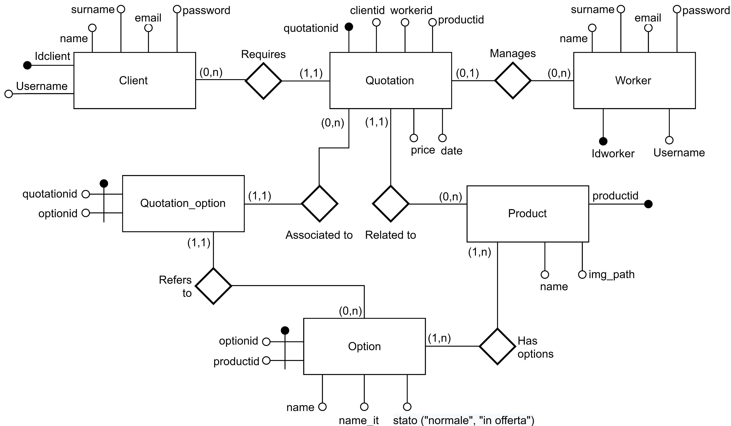
Database E-R model
NOTE: the database is in common between the pure HTML implementation and the RIA implementation
The option name is stored in two different languages to support the internationalization (HTML part only). We chose as languages English and Italian

Slide 6
Logical schema
CLIENT (IdClient, username, name, surname, email, password)
QUOTATION (quotationId, clientId, workerId, productid, price, date)
WORKER (idWorker, name, surname, email, password, username)
PRODUCT (productId, img_path, name)
OPTION (optionId, productid, name, name_it, stato)
QUOTATION_OPTION (quotationId, optionId)
In addition to these table, a VIEW has been created to easily authenticate the client and workers
USER(userId, username, name surname, email, password, role)
[the values has been taken from CLIENT and WORKER tables]

Slide 7
Note on image storage
To improve the flexibility of our application we decided to store all the images in the filesystem, in a path specified in the web.xml file. The DB is only used to store the names of the images files.
This allows to improve the application in two different aspects:
In case of a large number of products the DB would become quite big and unmanageable. Using a folder in the filesystem allows to manage and backup all the files separately from the rest of the data.
Allows the use of distributed systems: in real scenarios is quite common that the DBMS is not installed in the same machine where the other files of the application are stored. Building our application in the way described allows to setup it in such environments.

Slide 8
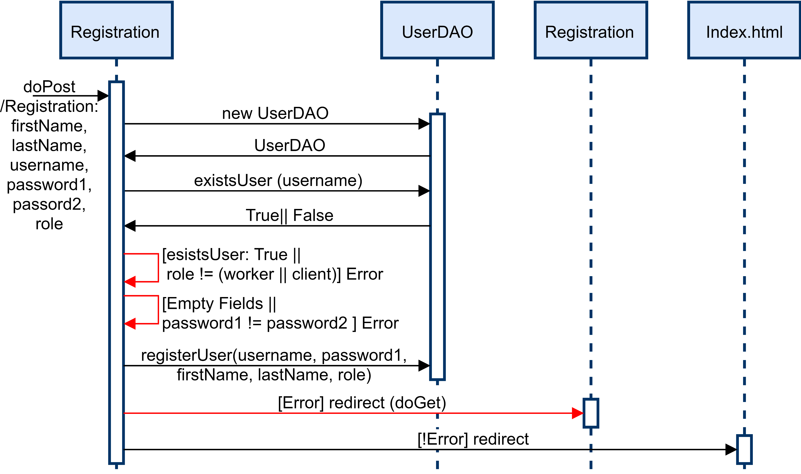
Note on image storage
The retrieval of the image by the client is managed through a special Servlet, that receive the request for a specific image, retrieve from the DB the name of the file and send the image back to the client as a bytestream. A glimpse of its behavior is given by the following sequence diagram.

Slide 9
Application requirements analysis
Un’applicazione web consente la gestione di richieste di preventivi per prodotti personalizzati. Un preventivo è
associato a un prodotto, al cliente che l’ha richiesto e all’impiegato che l’ha gestito. Il preventivo comprende una
o più opzioni per il prodotto a cui è associato, che devono essere tra quelle disponibili per il prodotto. Un
prodotto ha un codice, un’immagine e un nome. Un’opzione ha un codice, un tipo (“normale”, “in offerta”) e un
nome. Un preventivo ha un prezzo, definito dall’impiegato. Quando l’utente (cliente o impiegato) accede
all’applicazione, appare una LOGIN PAGE, mediante la quale l’utente si autentica con username e password.
Quando un cliente fa login, accede a una pagina HOME PAGE CLIENTE che contiene una form per creare un
preventivo e l’elenco dei preventivi creati dal cliente. Mediante la form l’utente per prima cosa sceglie il prodotto;
scelto il prodotto, la form mostra le opzioni di quel prodotto. L’utente sceglie le opzioni (almeno una) e conferma
l’invio del preventivo mediante il bottone INVIA PREVENTIVO. Quando un impiegato fa login, accede a una pagina
HOME PAGE IMPIEGATO che contiene l’elenco dei preventivi gestiti da lui in precedenza e quello dei preventivi
non ancora associati a nessun impiegato. Quando l’impiegato seleziona un elemento dall’elenco dei preventivi
non ancora associati a nessuno, compare una pagina PREZZA PREVENTIVO che mostra i dati del cliente (username)
e del preventivo e una form per inserire il prezzo del preventivo. Quando l’impiegato inserisce il prezzo e invia i
dati con il bottone INVIA PREZZO, compare di nuovo la pagina HOME PAGE IMPIEGATO con gli elenchi dei
preventivi aggiornati.
Pages (views), view components, events, actions

Slide 10
Note on form design choice
Mediante la form l’utente per prima cosa sceglie il prodotto; scelto il prodotto, la form mostra le opzioni di quel prodotto.
Since in pure HTML is not possible to update the content of a page without calling the server (there is no code run on the client beside the browser) we decided to split this form in two parts: the first one is a set of anchor images that can be clicked by the user. Once the user click on an image the server is called and the actual form with the options for that product is shown. In any case, in terms of behavior and graphic rendering, our choice reflect perfectly the requirements.

Slide 11
DAO & Model objects (common to HTML and RIA projects)
BEANS
OptionBean
ProductBean
UserBean
QuotationBean
quotationDao
getFreeQuotations()
getWorkerQuotations(int workerId)
getClientQuotations(int clientId)
getQuotationById(int quotationId)
addQuotation(int clientId, int productid, List Options)
userDao
checkCredentials(String username, String pwd)
existsUser(String username)
existsWorker(String username)
existsClient(String username)
registerUser([user information])
DAO (Data Access Objects)
optionDao
getOptionListByQuotation(int productid)
productDao
getAvailableProducts()
getProductById(int productid)
getImagePath(int productid)

Slide 12
PURE HTML APPLICATION
This section of the documents describes the main architectural and implementation choices we made for what the pure HTML part of the project is concerned.
All the graphs and diagrams in this sections has been simplified as much as possible to provide a clear view on how the application must be developed, focusing on the main aspects to be kept in mind while programming it.

Slide 13
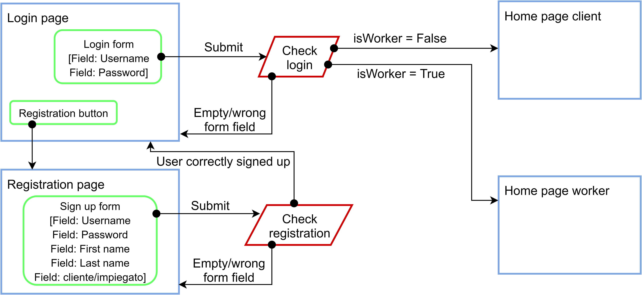
Application design: Login and registration

Slide 14
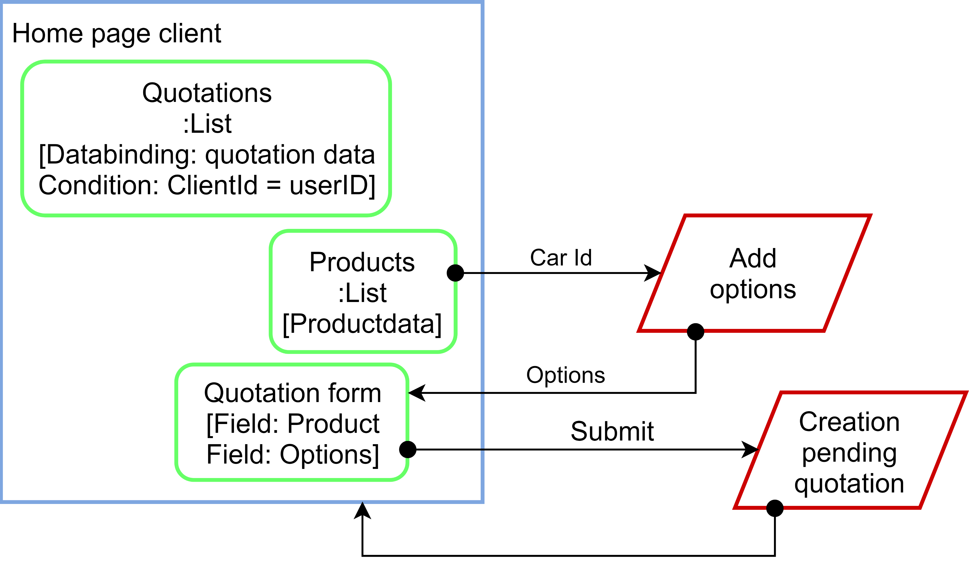
Application design: Client page
This interaction highlights the fact that the option fields are populated with the options available for the selected car

Slide 15
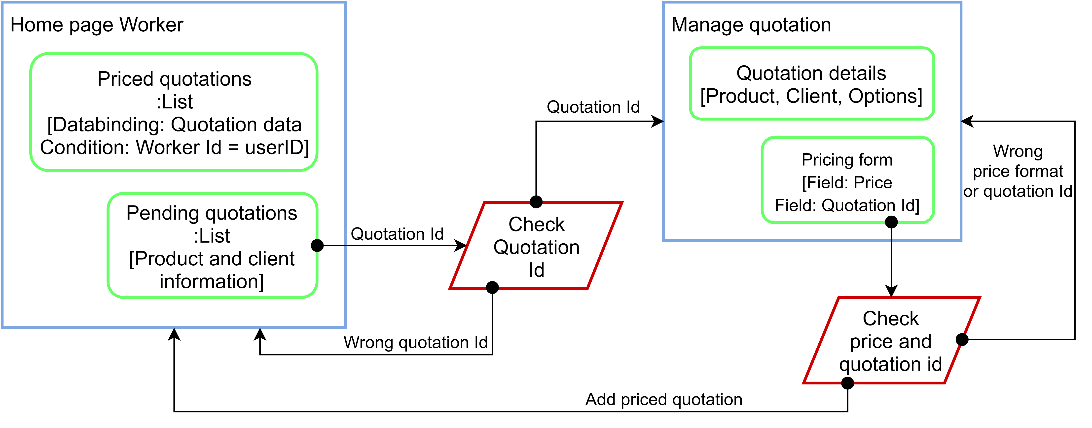
Application design: Worker page

Slide 16
Controllers & Views
CONTROLLERS
HomeClient
HomeWorker
Index
Login
Logout
ManageQuotation
Registration
SubmitRequest
VIEWS
Login page
Login form
Registration page
Registration form
Home worker
Table with past quotations
Table with pending quotations
Manage quotation page
Table with the details of the request
Table with the options selected
Form to submit a price
Home client
Table with submitted requests
Form to submit a quotation request

Slide 17
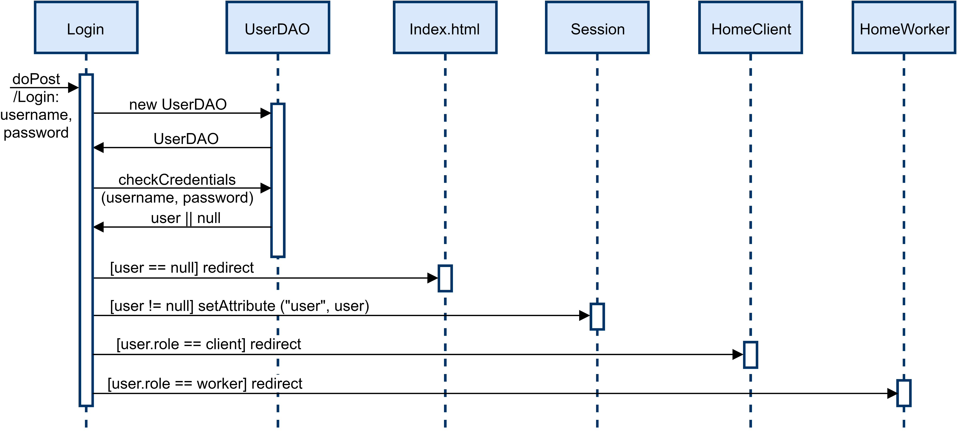
Event: Login (Worker & Client)

Slide 18
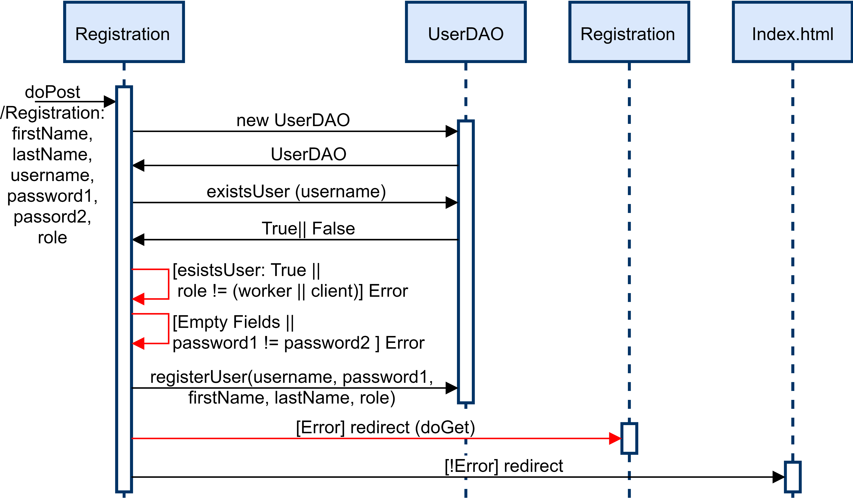
Event: Registration
With the red arrows are highlighted the main errors that can arise in the interaction and the way they are managed

Slide 19
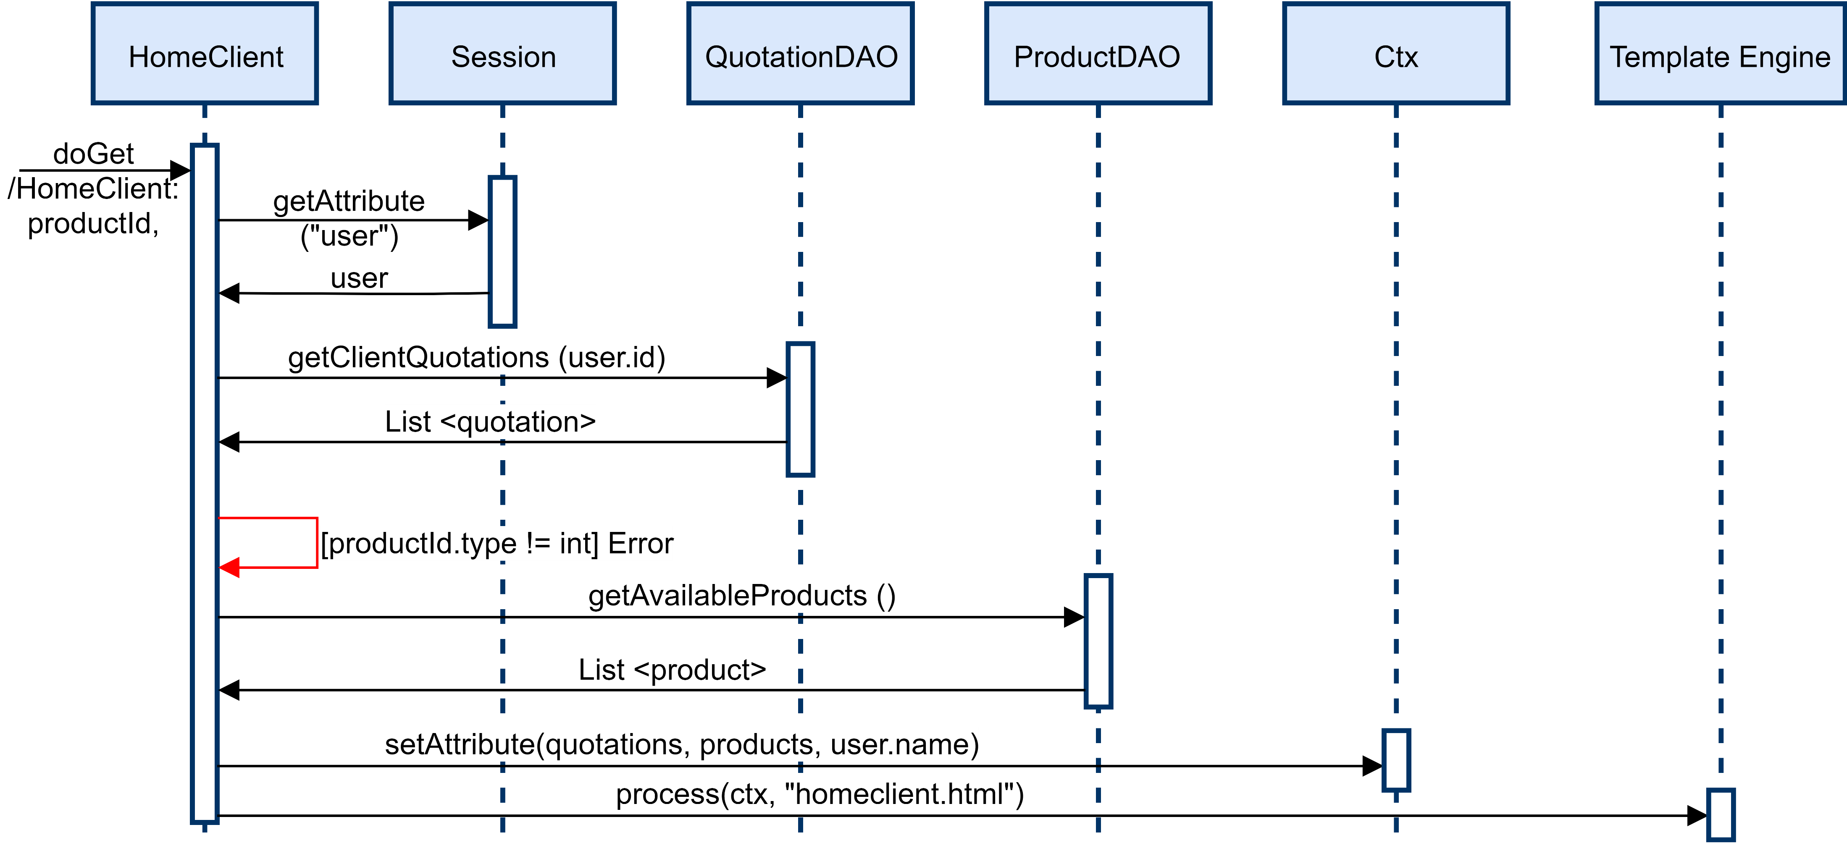
Event: Client access home page
productId is not a mandatory parameter of the request: if this value is not null the page will show the form to select the options and send a quotation request for the relative product.

Slide 20
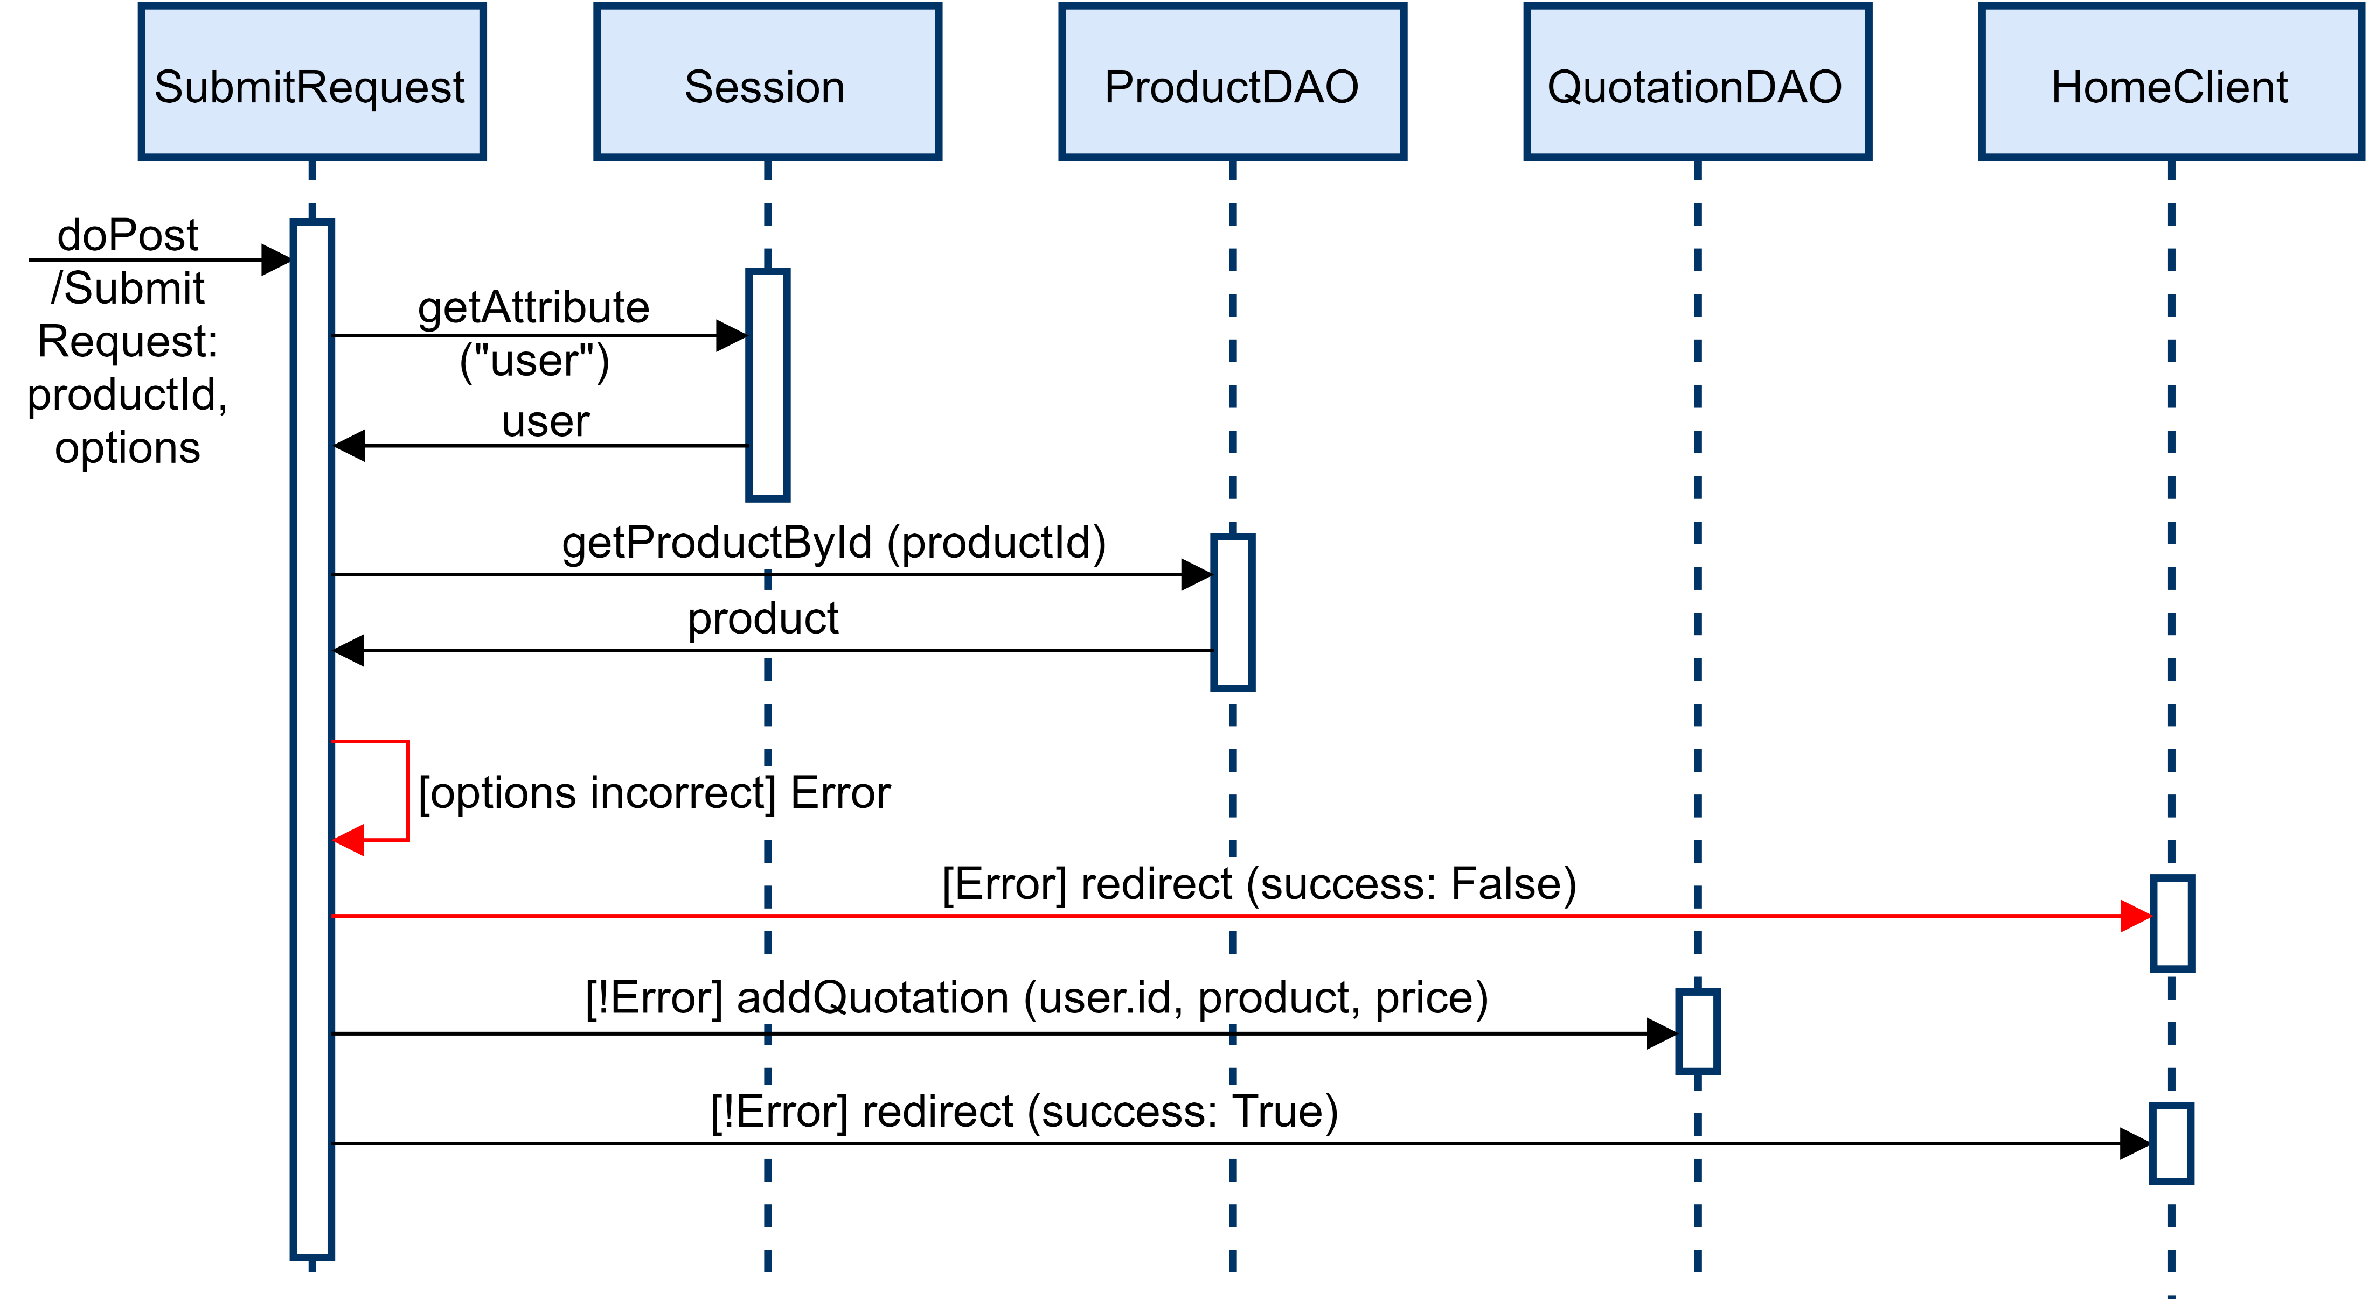
Event: Client submit a request
*
NOTICE: further information about how the redirection in case of error in managed are provided at the end of this part of the document.

Slide 21
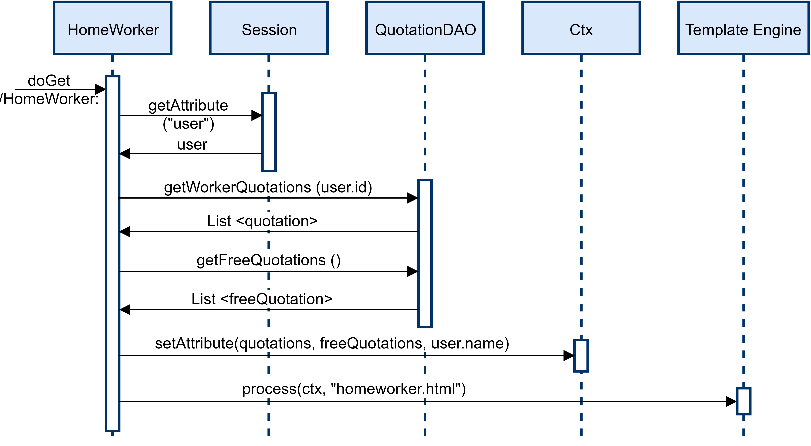
Event: Worker access home page

Slide 22
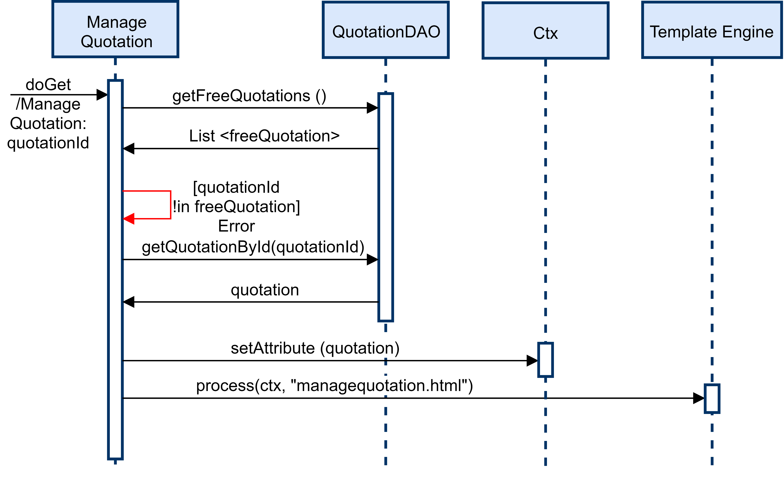
Event: Worker access quotation page

Slide 23
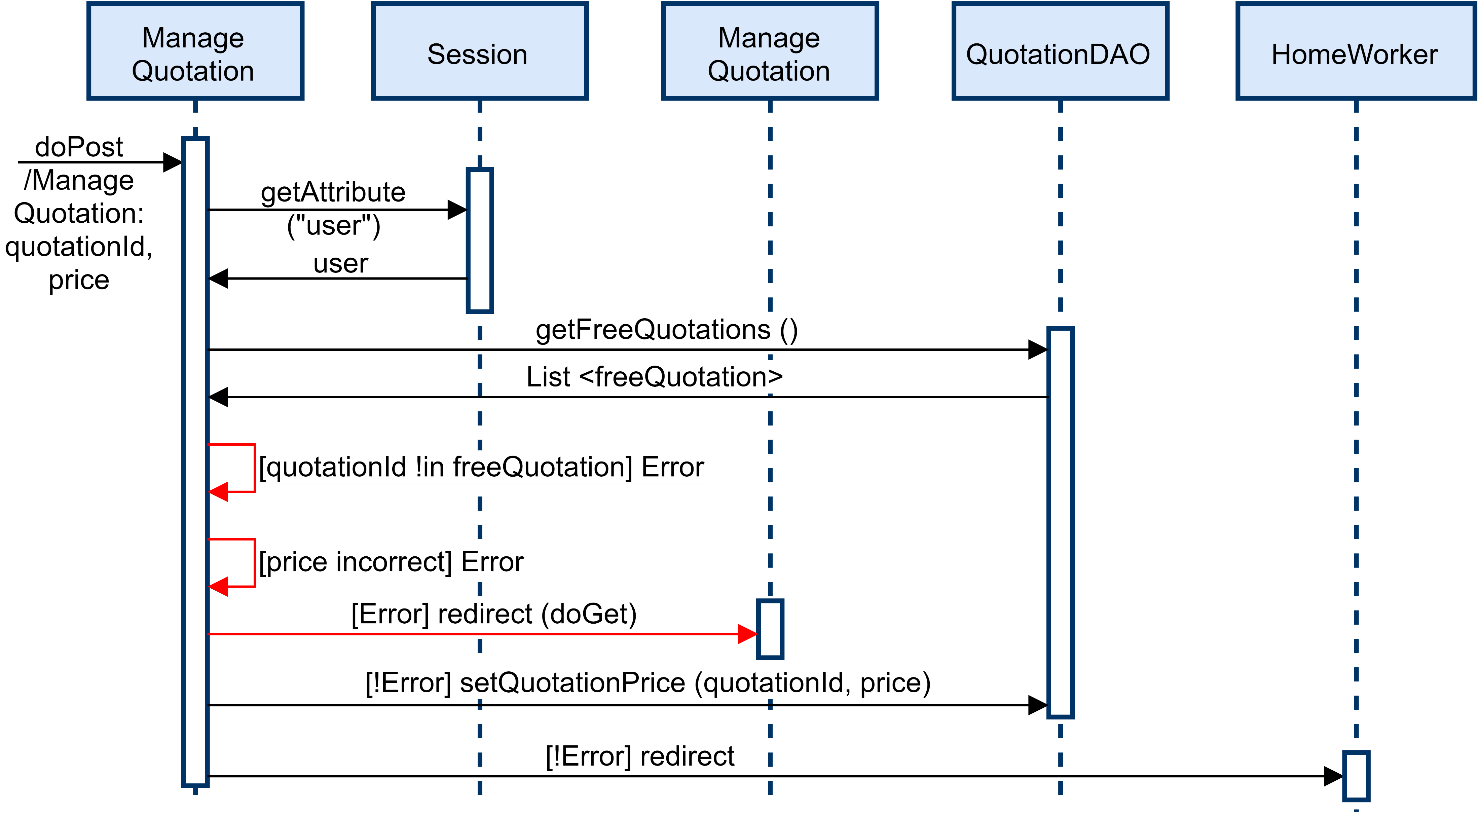
Event: Worker set a quotation price

Slide 24

*exploit the cookies to show an error message to the user
(generic overview)
6. The cookie is invalidated and the response page is prepared with the error message
1. The client submit a POST request using a form in a HTML PAGE
2. An error is detected; the POST request is not valid (e.g. the values inserted are wrong or not complete)
POST management servlet
HTML page
(servlet)
3. A cookie is added to the response
4. The user receives a sendRedirect message to the original HTML page
5. The user send a request to the servlet that manages the HTML page, including the cookie in the request
7. The user receives a page that is identical to the one he started from but with an error message

Slide 25
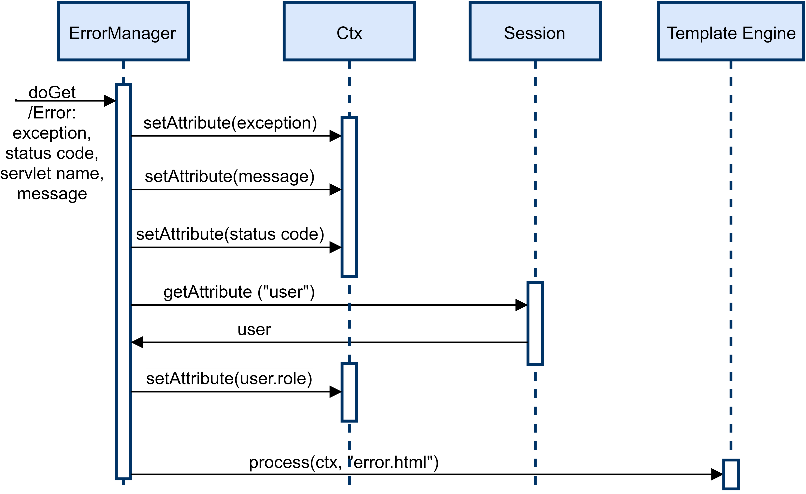
Error management
The special servlet described by the sequence diagram below, binded using the <Error> tag in the web.xml file, manages the arise of exceptions in the code, substituting the default pages of TomCat.

Slide 26
Filters
To pre-process the requests coming from the server we have developed a set of filters to perform checks on the user session. In the following slides are reported the ones used for the HTML part of the project.

Slide 27
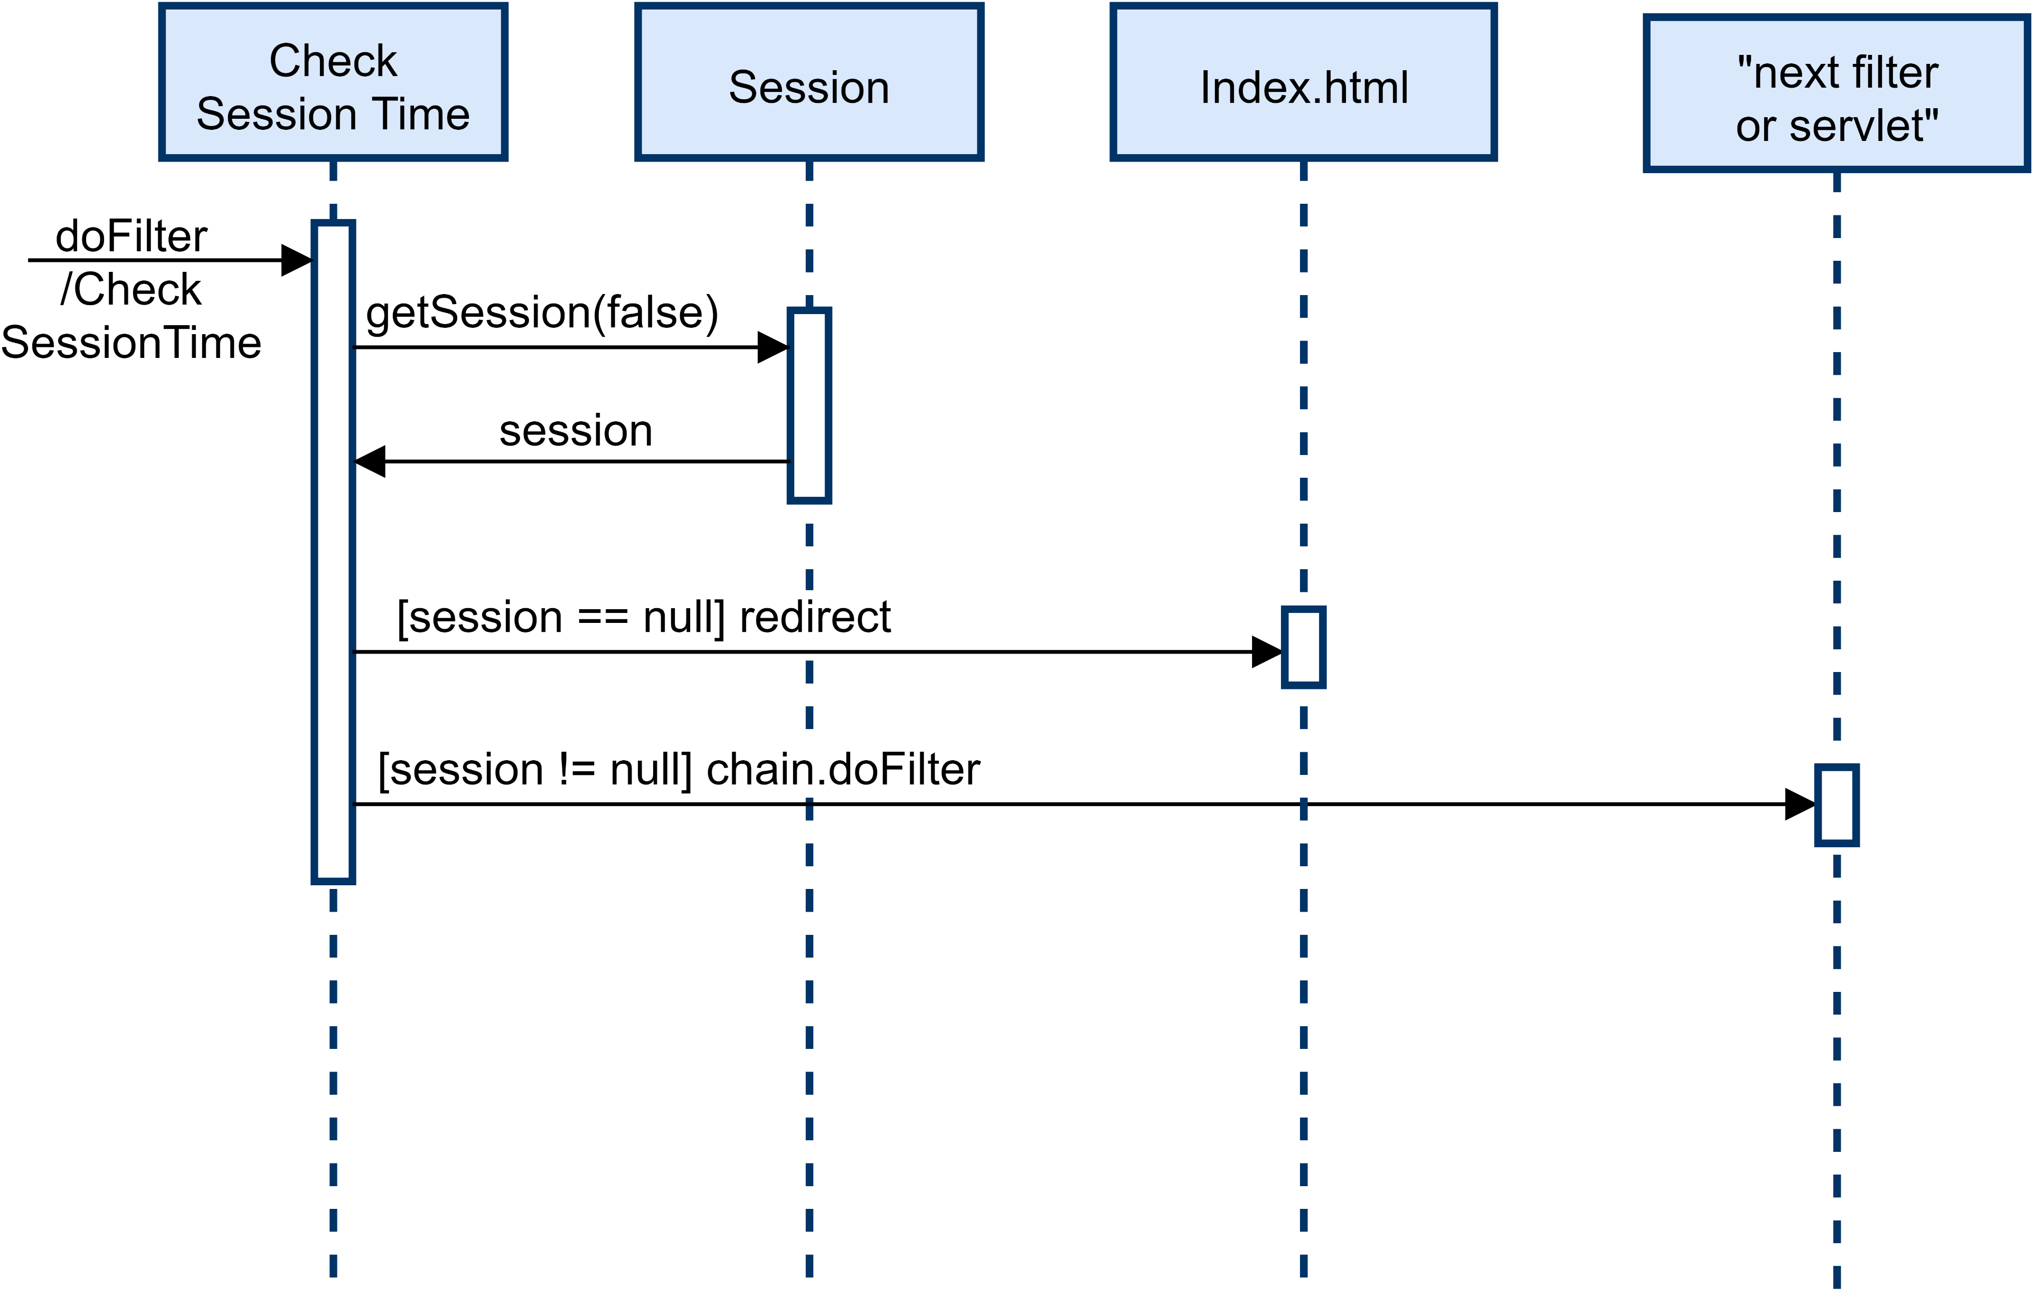
Filter: check if the user is authenticated

Slide 28
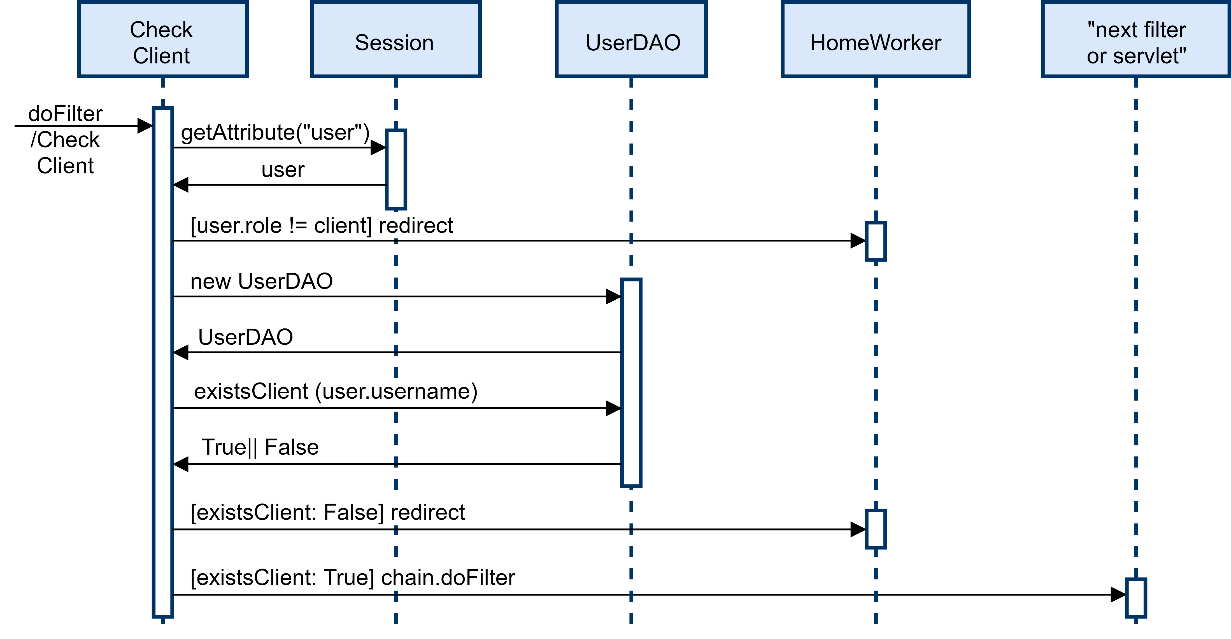
Filter: check if the user is a client

Slide 29
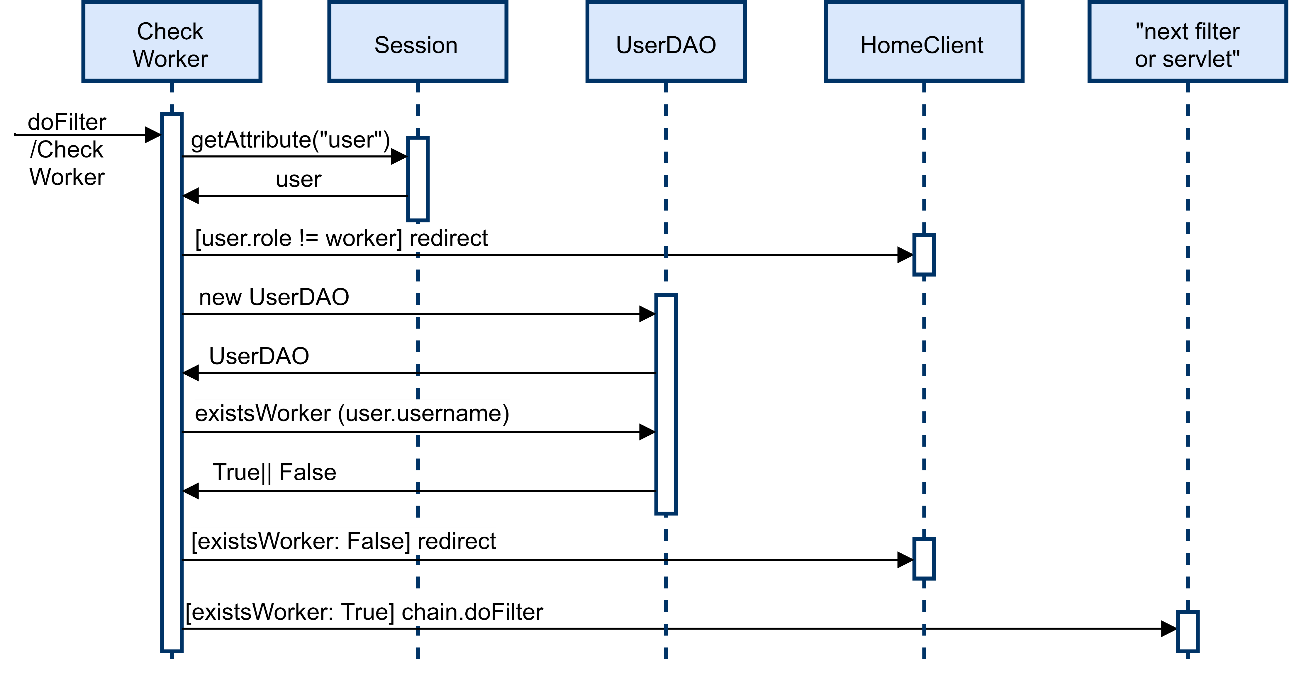
Filter: check if the user is a worker

Slide 30
RIA APPLICATION
This section of the documents describes the main architectural and implementation choices we made for what the RIA part of the project is concerned.
All the graphs and diagrams in this sections has been simplified as much as possible to provide a clear view on how the application must be developed, focusing on the main aspects to be kept in mind while programming it.

Slide 31
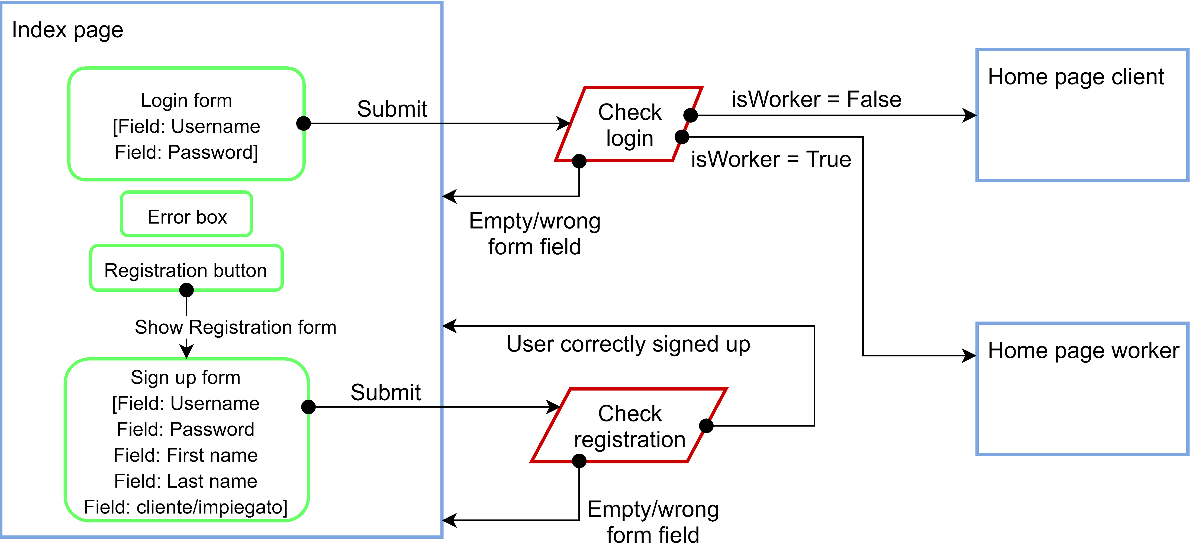
Application design: Login and registration

Slide 32
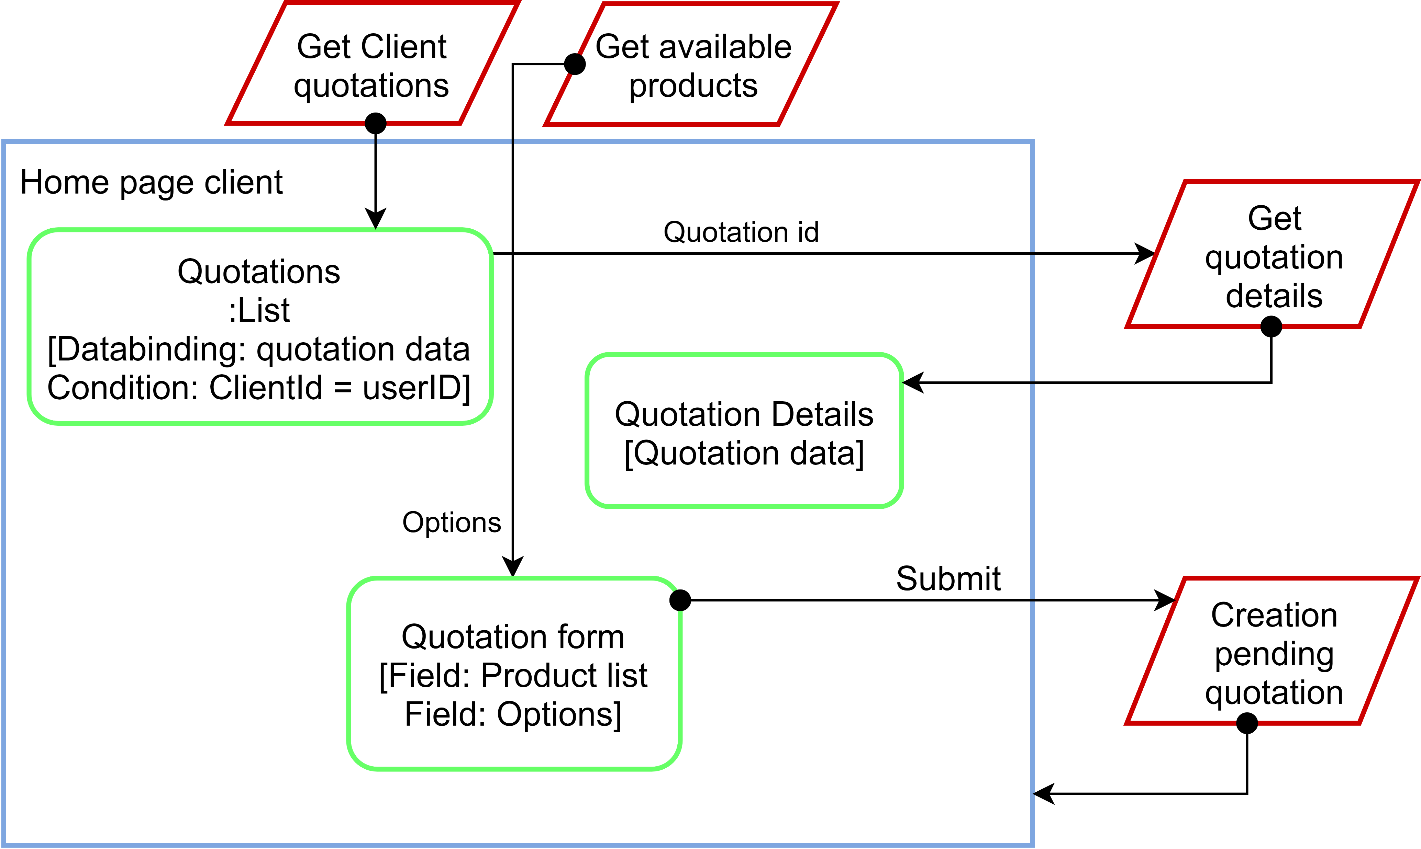
Application design: Client page

Slide 33
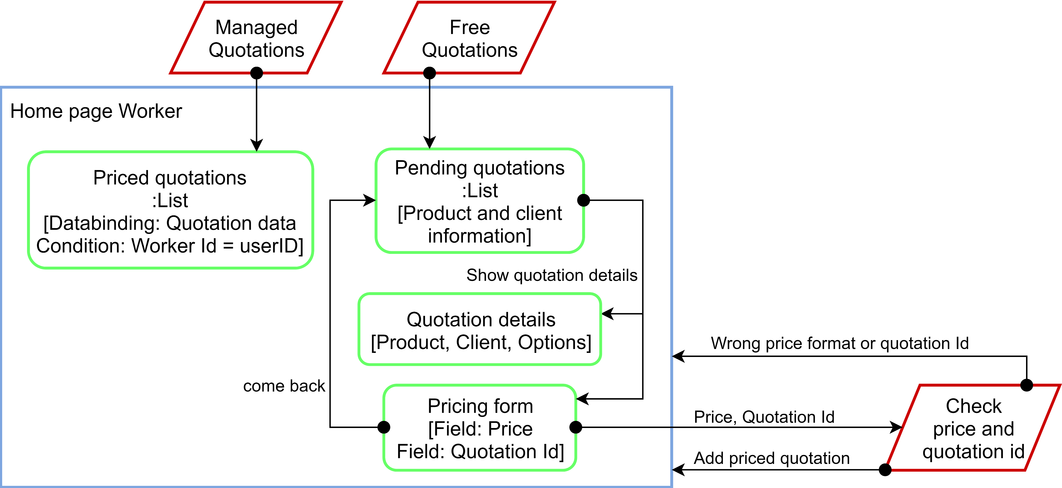
Application design: Worker page

Slide 34
Client side – Client page: view components
NameField
Show()
ErrorBox
Hide()
SetError()
SetSuccess()
RequestTable
Show()
Update()
EmptyTable()
QuotationDetails
showInv()
Show()
Update()
RequestForm
Show()
updateProds()
showDetails()
registerEvents()

Slide 35
Events & actions - CLIENT
CLIENT SIDE |  | SERVER SIDE
Event | Action | Event | Action
Home page -> Load | Update the view with old requests of the user | GET | Get the past requests of the client
Home page -> Load | Update the view with the available products | GET | Get the list of the available products
Request list -> Select quotation | Show a box with the details of the selected quotation | GET (quotationId) | Get the details of the selected quotation
Product form -> Select a product | Show the options available for the selected product | (No requests since the data are downloaded on page load (see the 2nd event))
Submit a request | Check if the user selected at least an option | POST (productid, options) | Check the parameters and store the request

Slide 36
Controller & Events - CLIENT
CLIENT SIDE |  | SERVER SIDE
Event | Controller | Event | Controller
Home page -> Load | Orchestrator -> refresh() RequestTable -> show() | GET | GetClientRequests
Home page -> Load | Orchestrator -> refresh() RequestForm -> show() | GET | GetAvailableProducts
Request list -> Select quotation | Function MakeCall | GET (quotationId) | GetQuotation
Product form -> select a product | RequestForm.showDetails() | (No requests since the data are downloaded on page load (see the 2nd event))
Submit a request | Function MakeCall (passing a form) | POST (productid, options) | SubmitRequest

Slide 37
Client side – Worker page: view components
NameField
Show()
Hide()
ErrorBox
Hide()
SetError()
SetSuccess()
QuotationTable
hide()
show()
update()
FreeTable
Hide()
Show()
Update()
PriceQuotation
hide()
show()
update()
Options
Hide()
Show()
Update()
PriceForm
Hide()
Show()
Update()

Slide 38
Events & actions - WORKER
CLIENT SIDE |  | SERVER SIDE
Event | Action | Event | Action
Home page Worker -> Load | Show and update Managed Quotations | GET | Get the past requests of the client
Home page Worker -> Load | Show and update Free Quotations | GET | Get the list of the available products
Free quotation List -> show quotation details | Show the details of the quotation and the pricing form | (No interactions)
Pricing form -> come back | Show the Free Quotation table and the Managed quotation table | (No interactions)
Free Quotation List -> Show pending request -> submit price | Check price and quotation Id, then show quotation Details and Pricing form. | POST (price, quotation ID) | Check price and quotation id and change state.

Slide 39
Controller & Events - WORKER
CLIENT SIDE |  | SERVER SIDE
Event | Action | Event | Action
Home page Worker -> Load | Orchestrator -> Managed Quotation -> makeCall | GET | ManagedQuotations
Home page Worker -> Load | Orchestrator -> Free Table -> makeCall | GET | FreeQuotations
Free quotation List -> show quotation details | Orchestrator -> changeToPricePage | (No interactions)
Pricing form -> come back | Orchestrator -> Refresh | (No interactions)
Free Quotation List -> Show pending request -> submit price | pricePost -> makeCall | POST (price, quotation ID) | PricePost

Slide 40
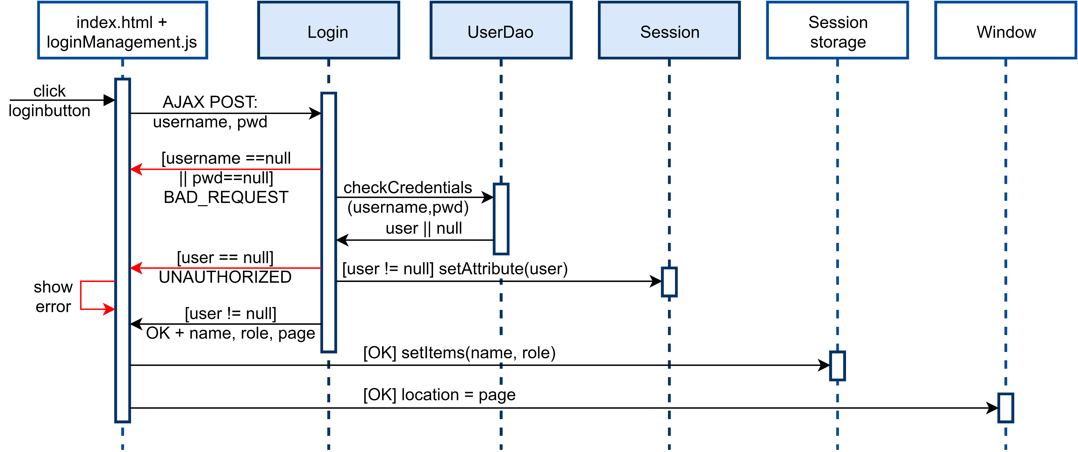
Event: Login (Worker & Client)

Slide 41
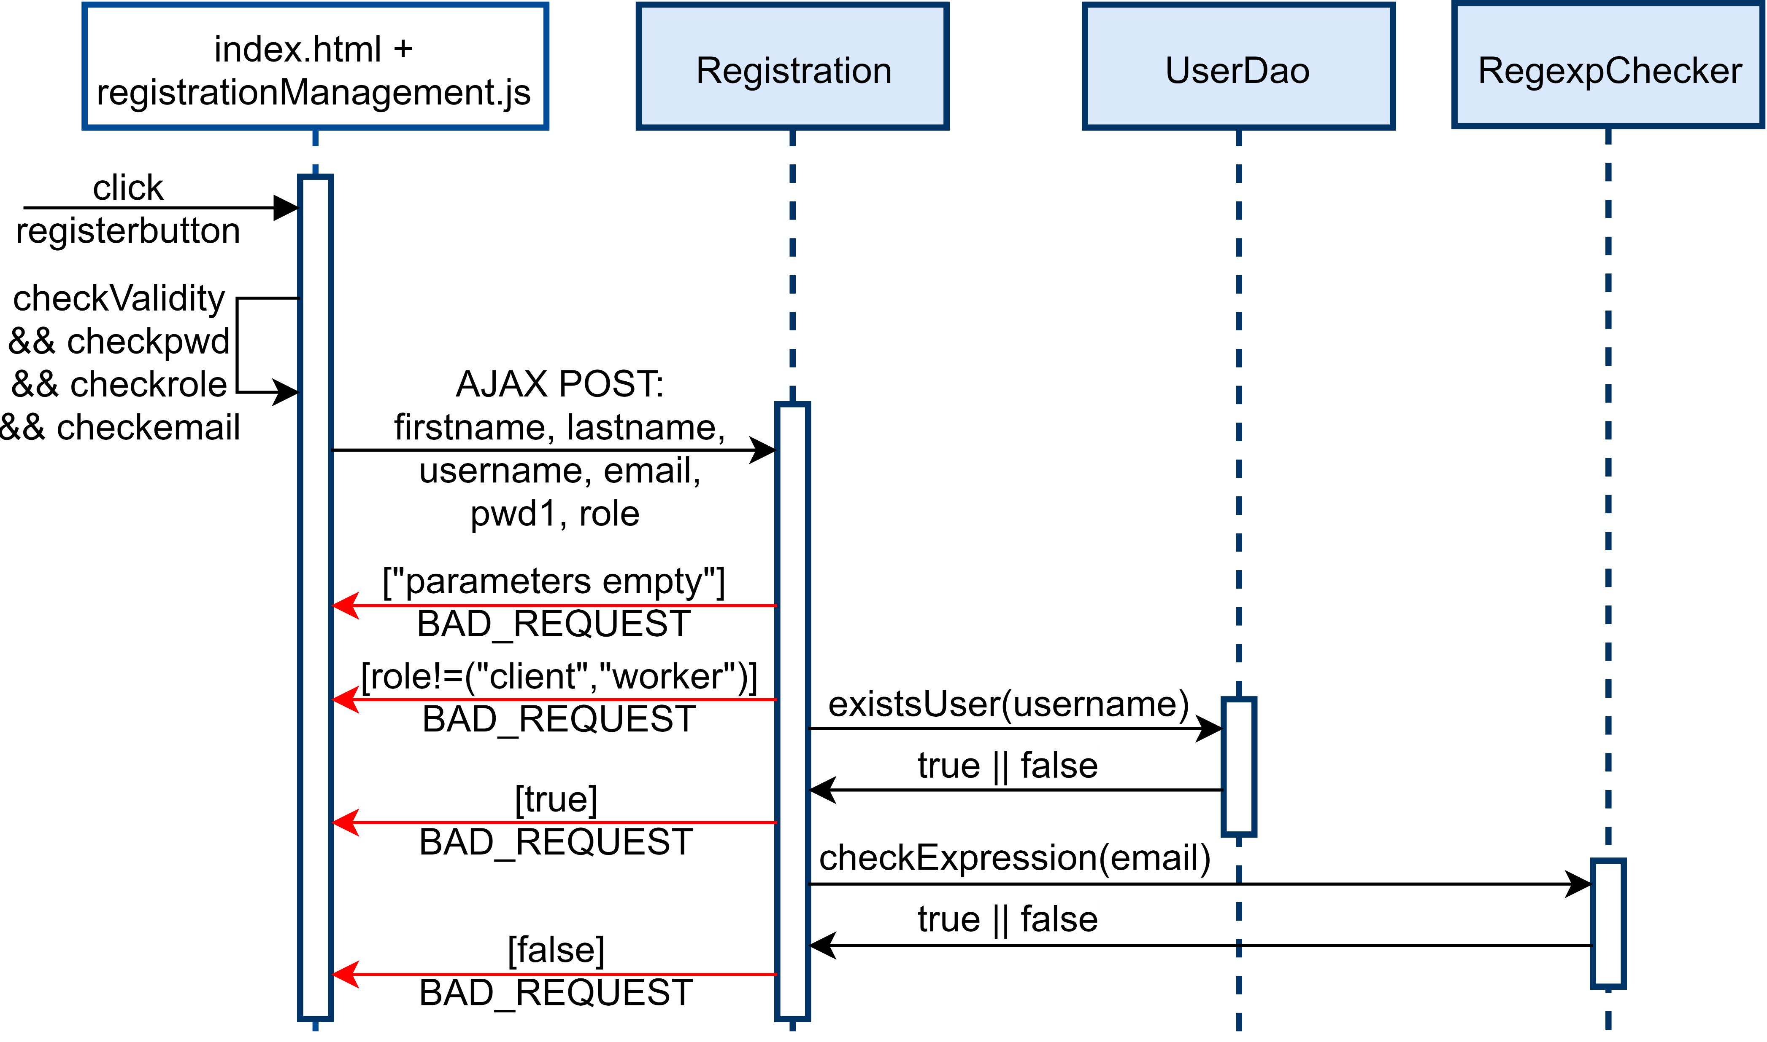
Event: Registration (pt.1)

Slide 42
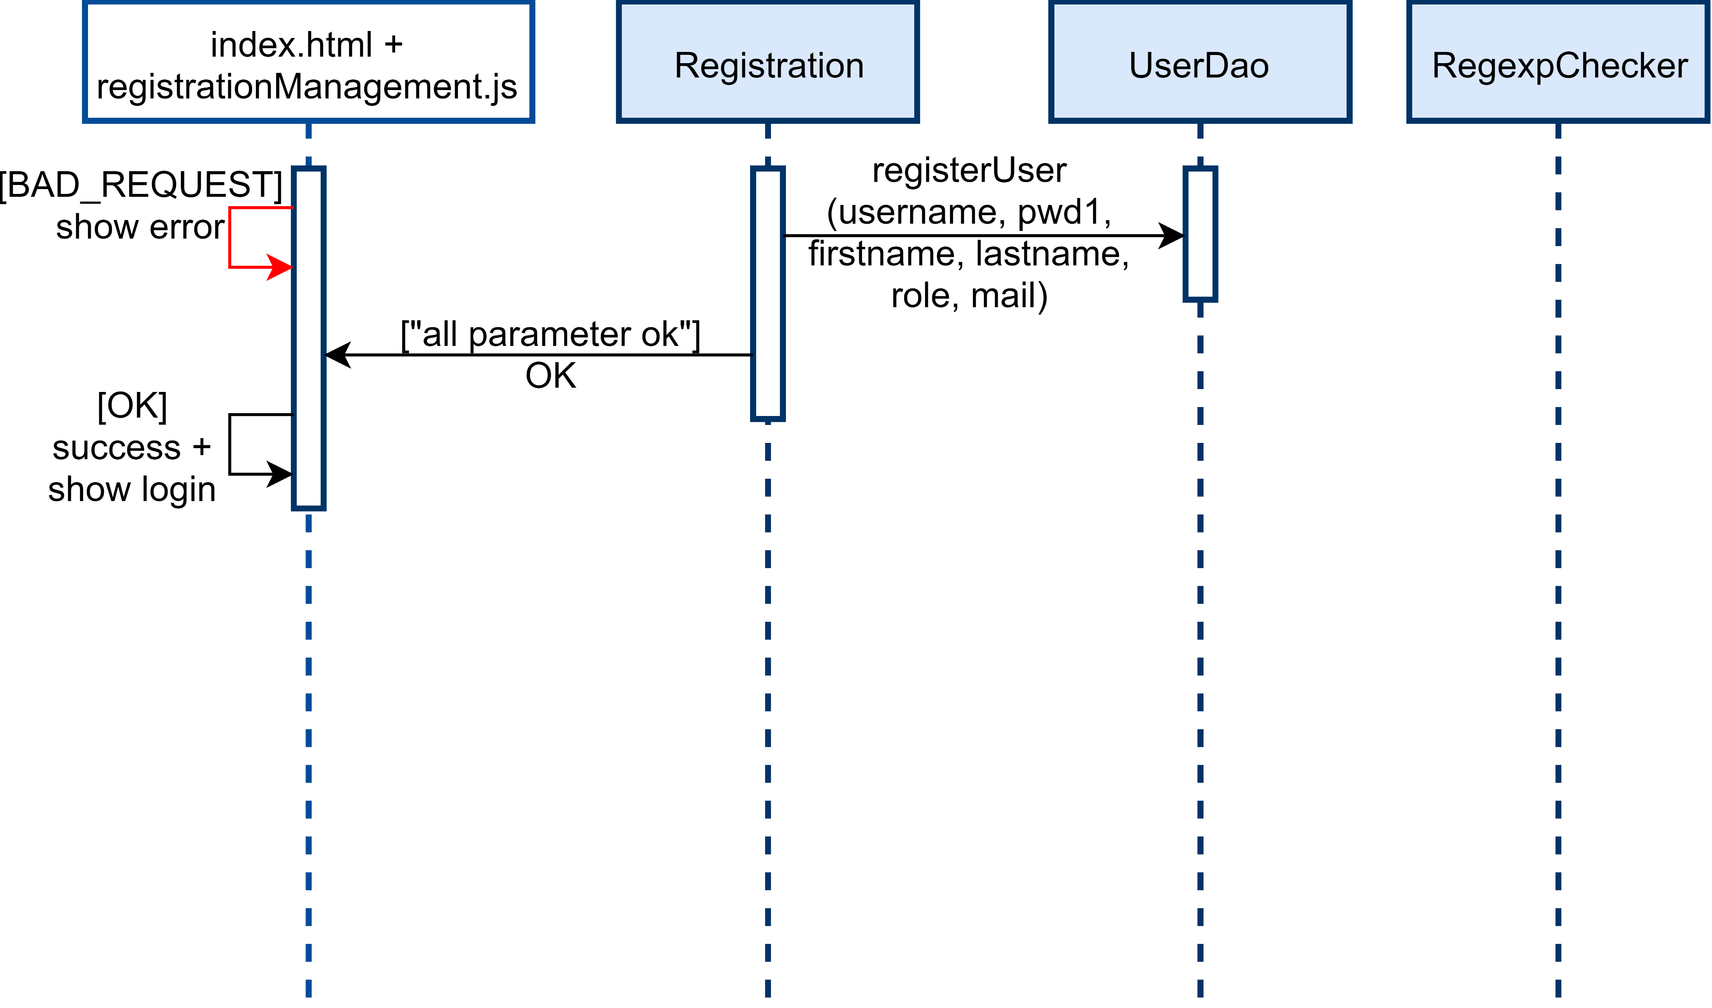
Event: Registration (pt.2)

Slide 43
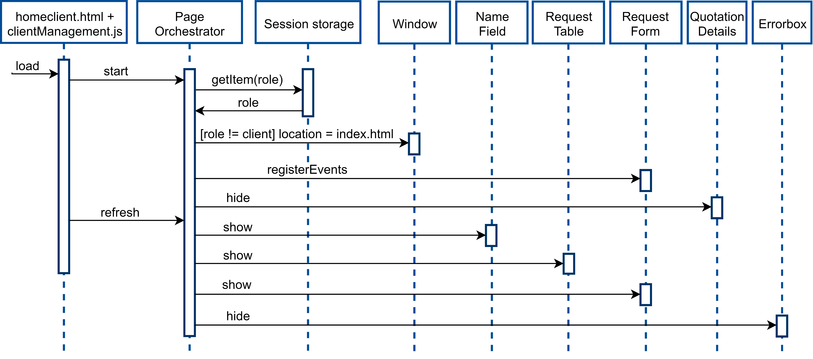
Event: Client access home page (pt.1)

Slide 44
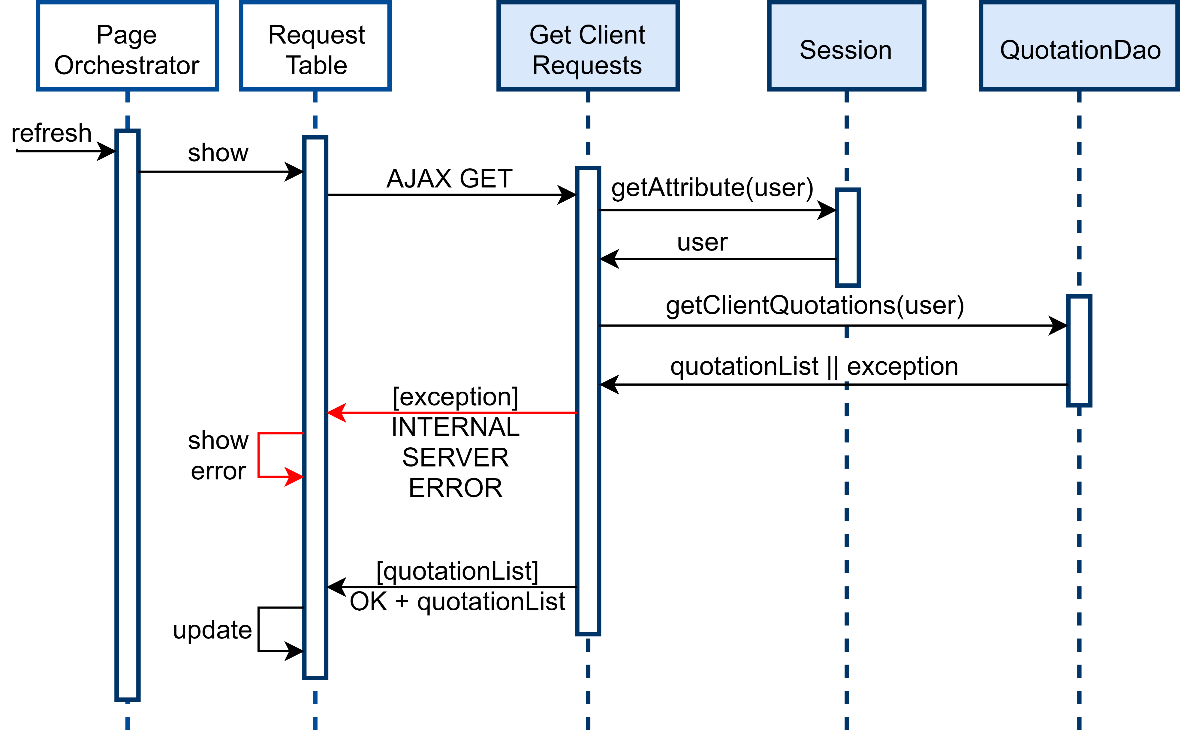
Event: Client access home page (pt.2)

Slide 45
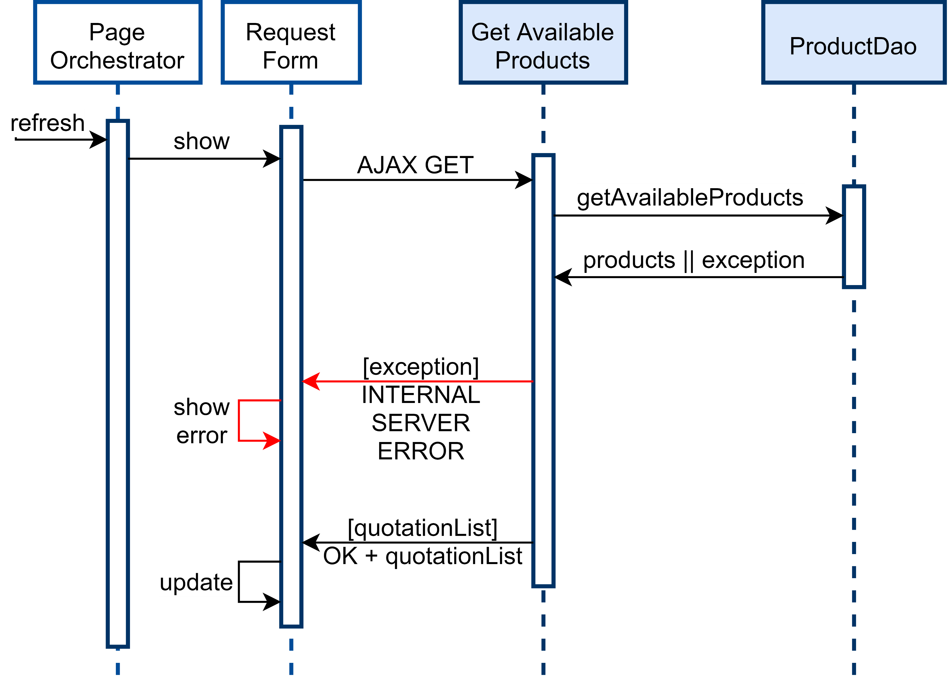
Event: Client access home page (pt.3)

Slide 46
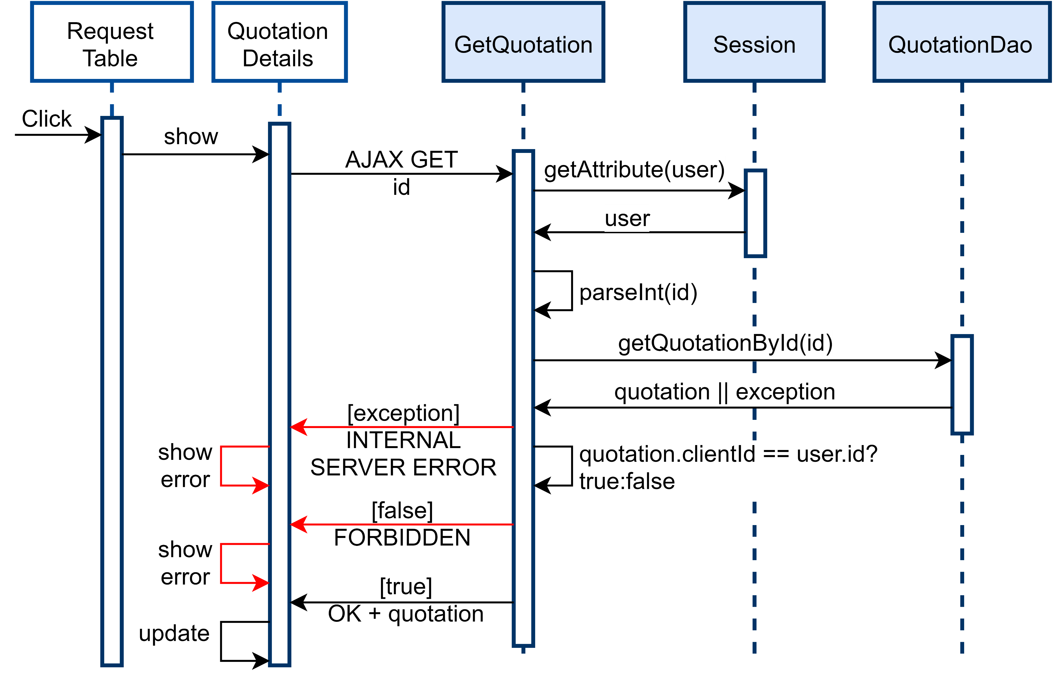
Event: Show quotation details

Slide 47
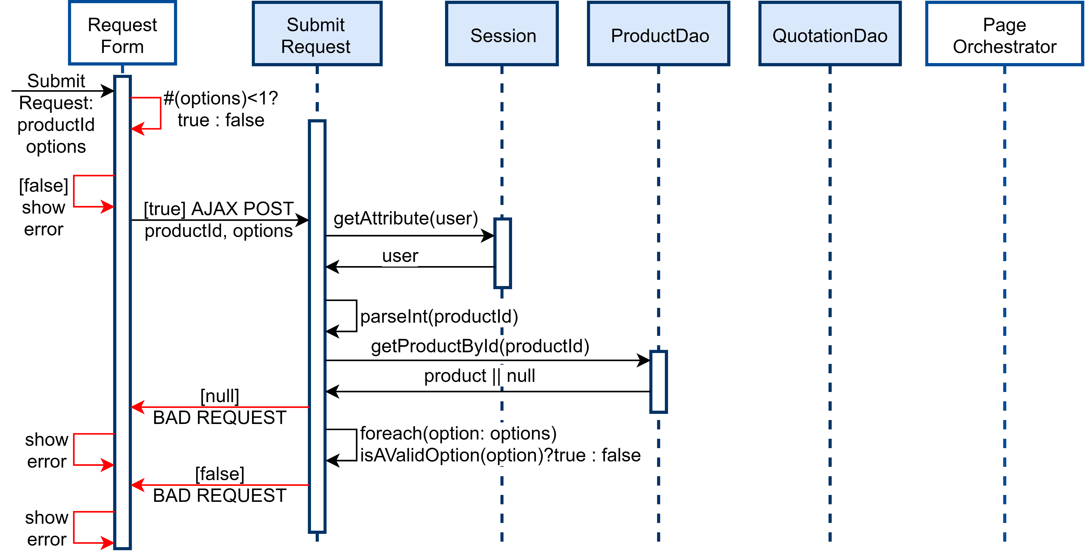
Event: Submit a new request (pt.1)

Slide 48
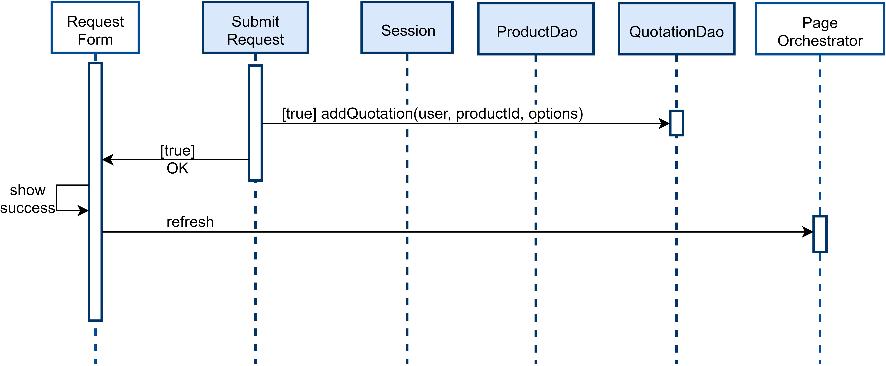
Event: Submit a new request (pt.2)

Slide 49
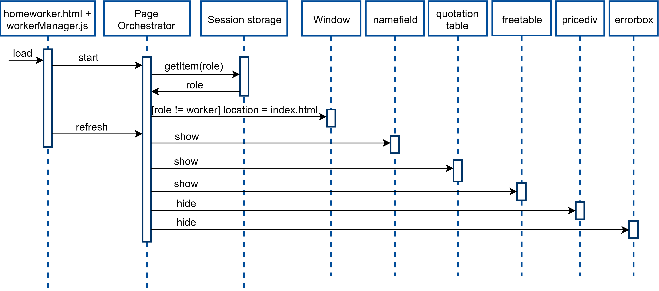
Event: Worker access home page (pt.1)

Slide 50
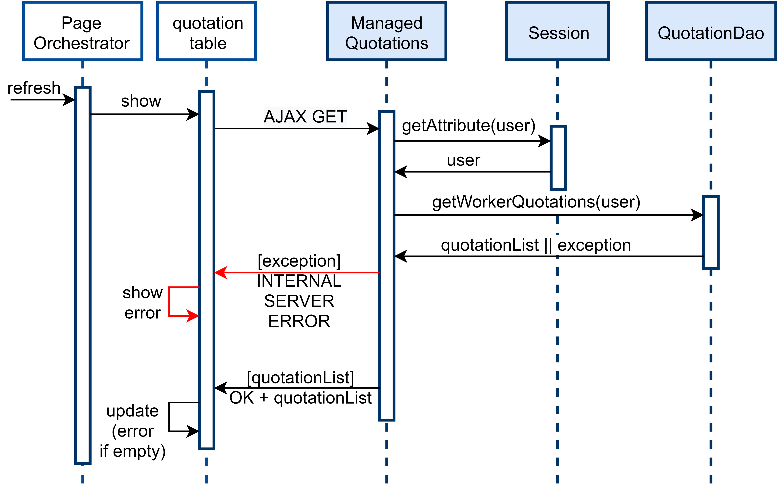
Event: Worker access home page (pt.2)

Slide 51
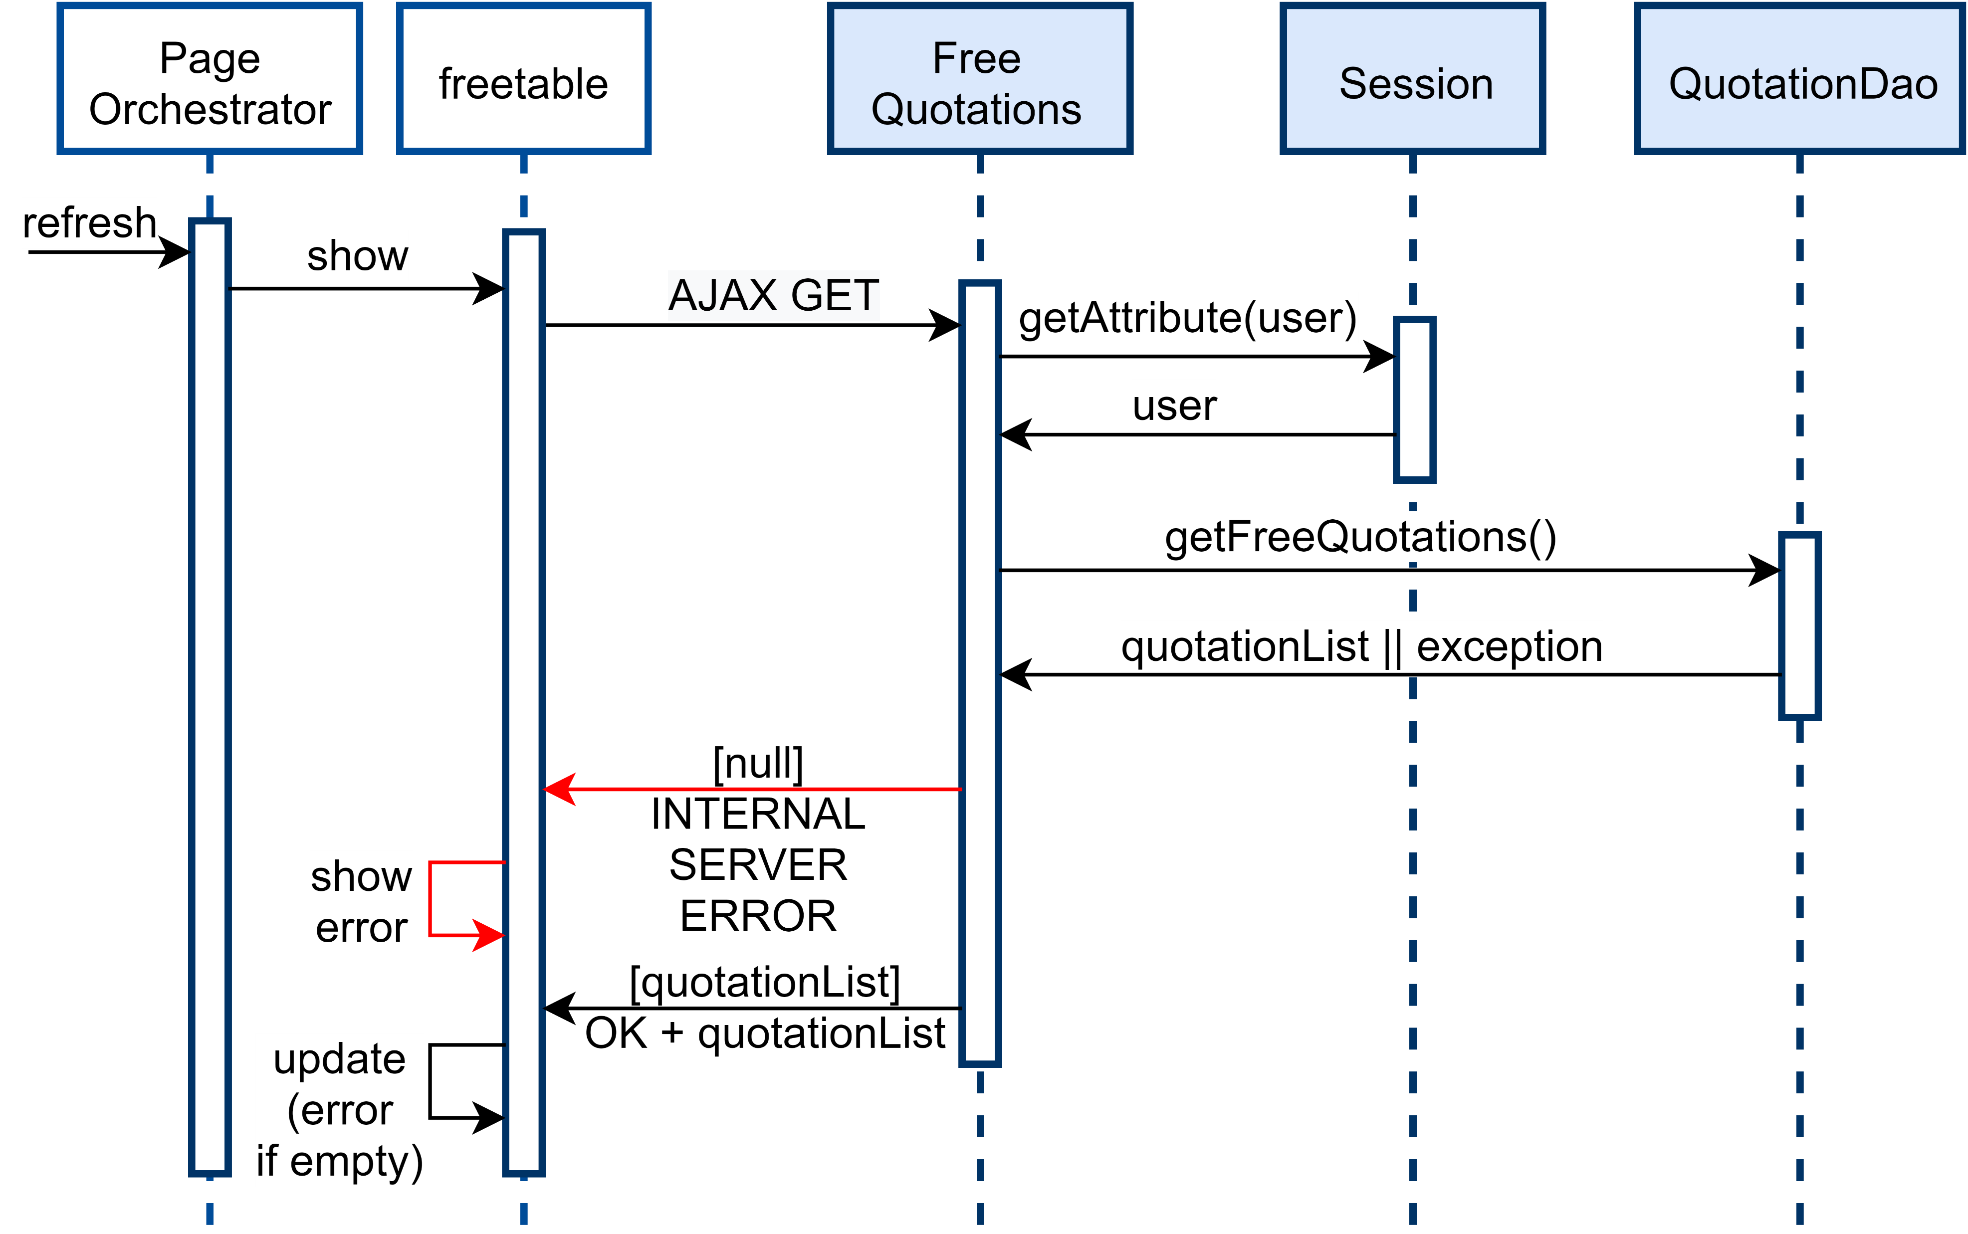
Event: Worker access home page (pt.3)

Slide 52
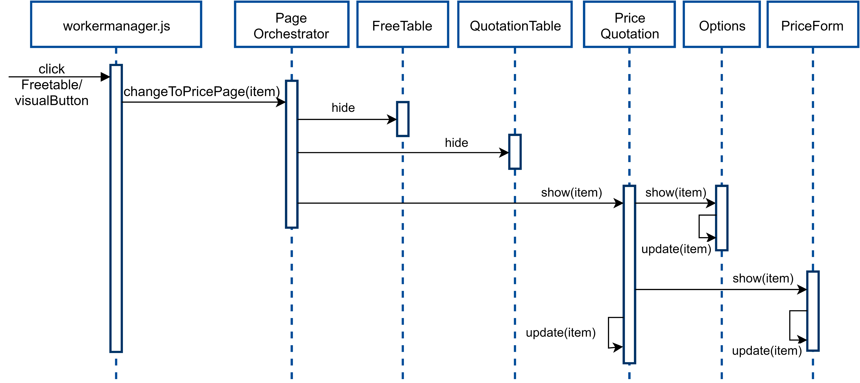
Event: Show price form

Slide 53
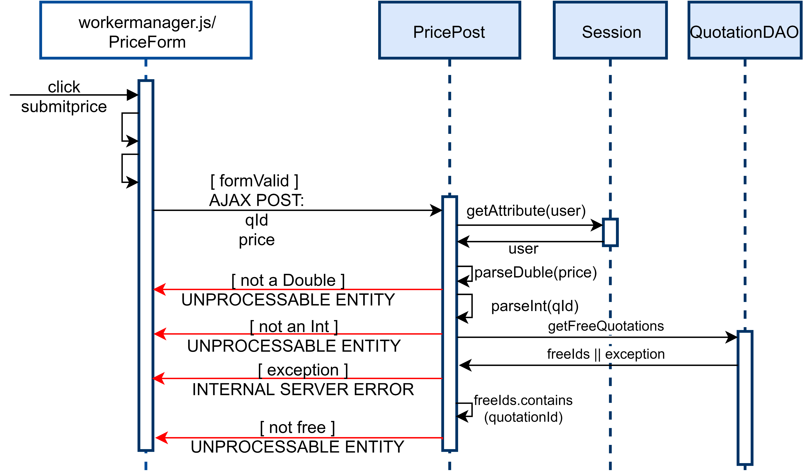
Event: Add a price to a quotation (pt.1)

Slide 54
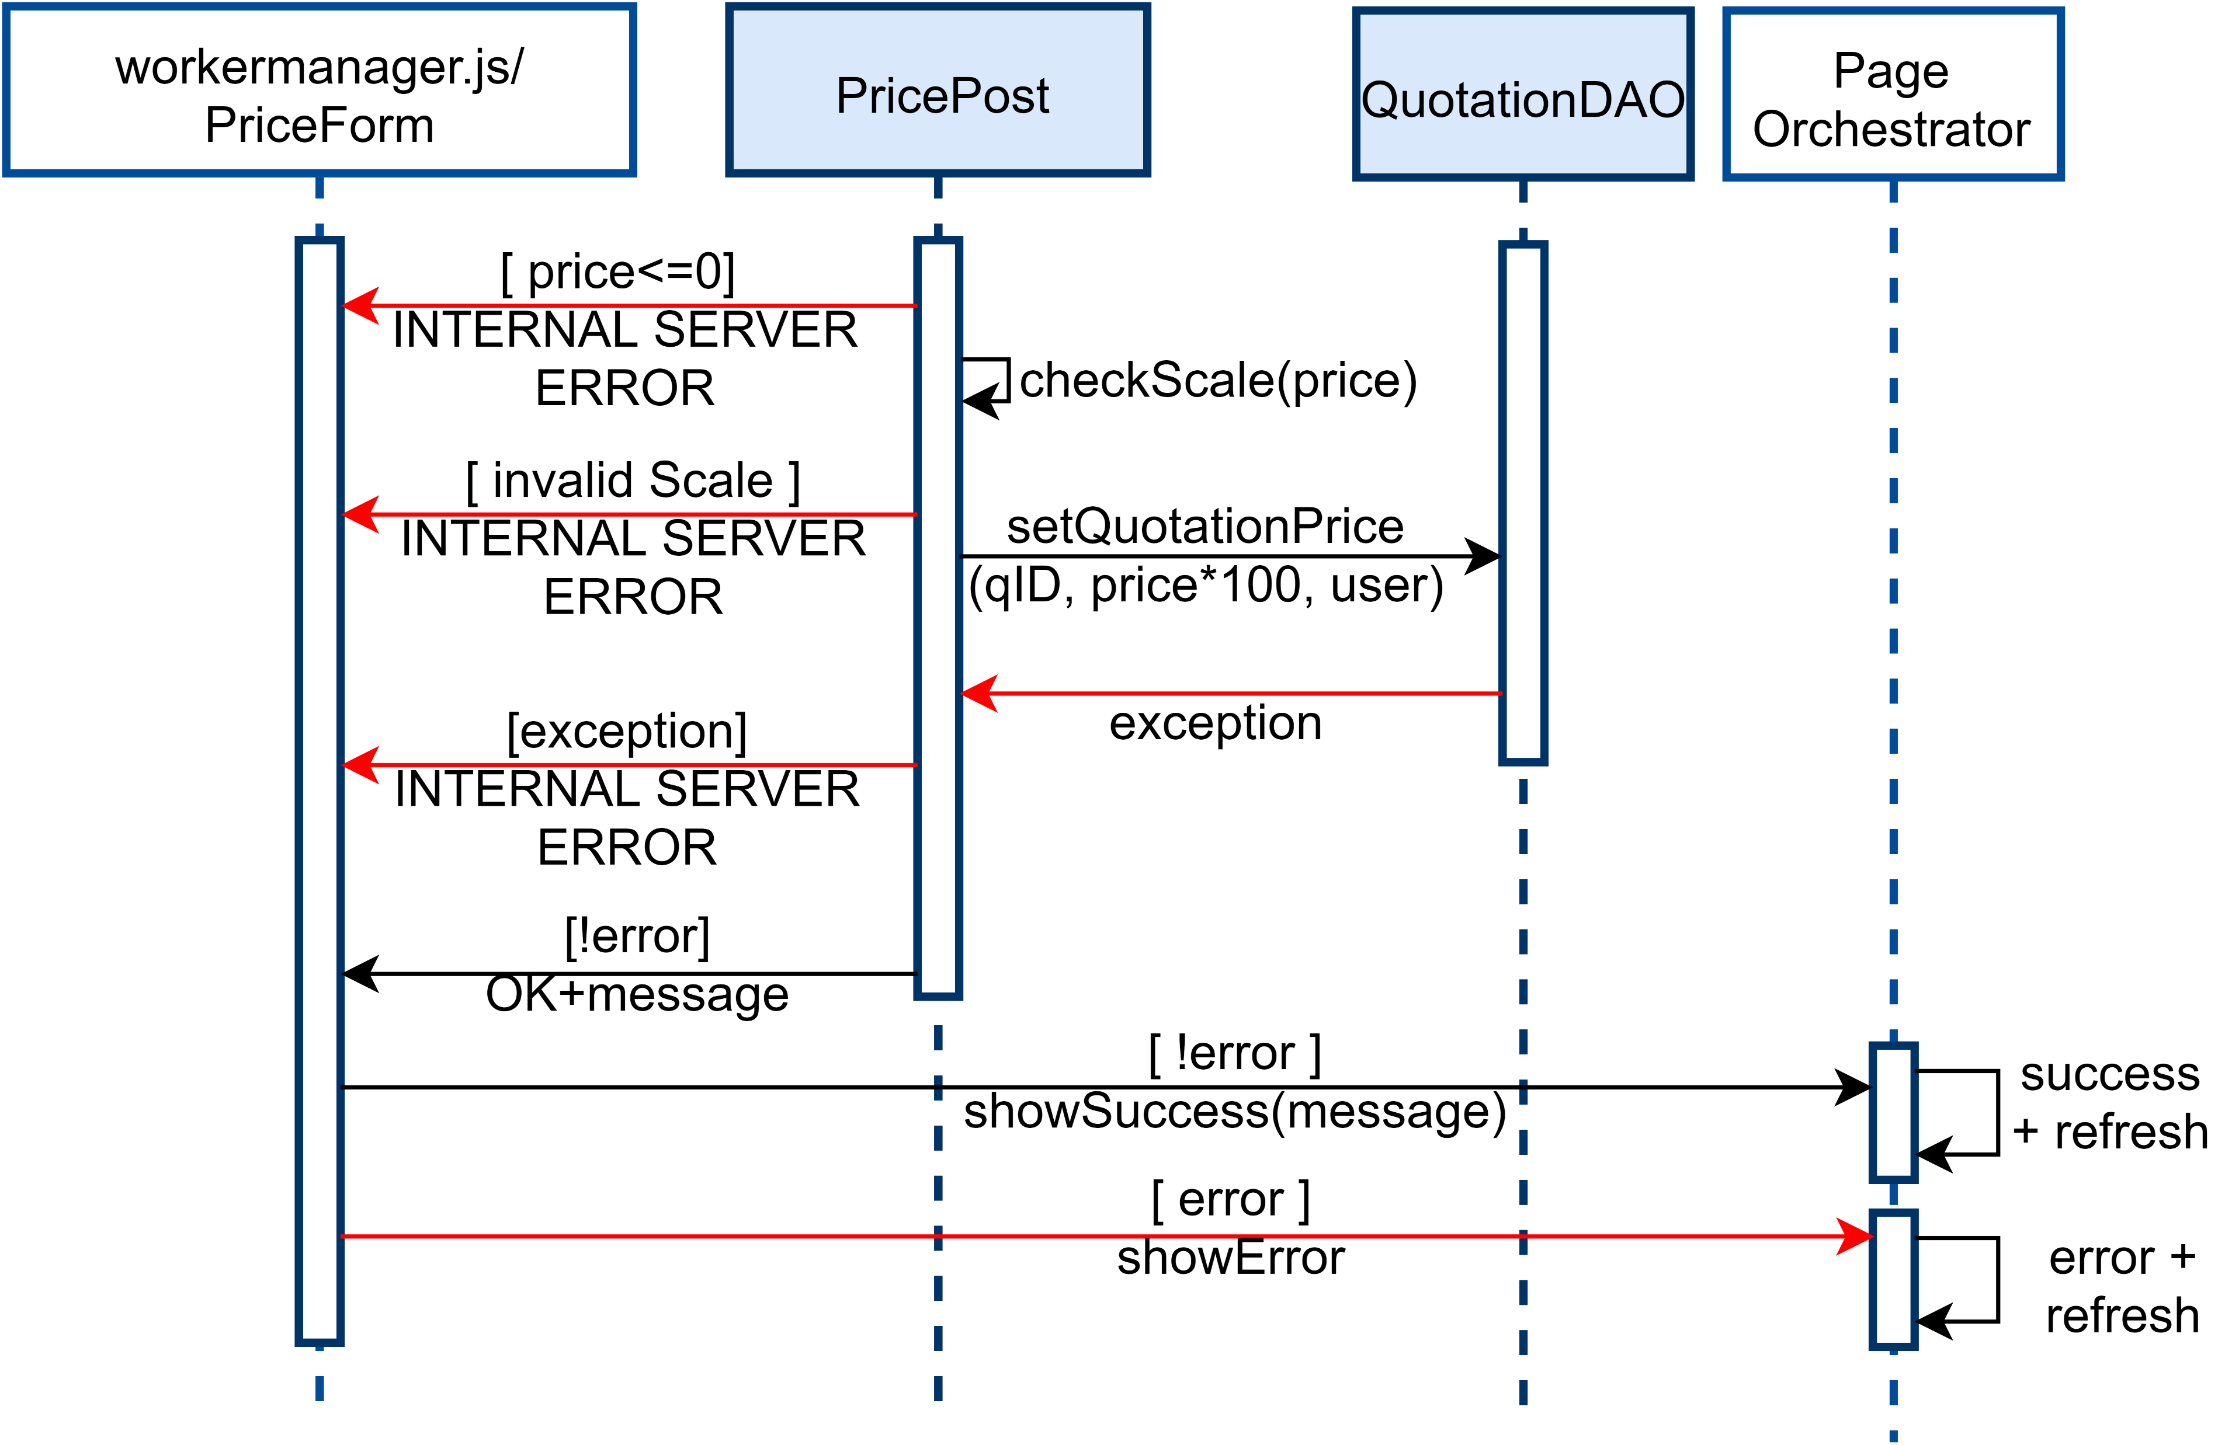
Event: Add a price to a quotation (pt.2)

Slide 55
Filters
To pre-process the requests coming from the server we have developed a set of filters to perform checks on the user session. In the following slides are reported the ones used for the RIA part of the project. Unlike the ones used for HTML part, that send a redirect (302) to the client, these one send a 403 message (FORBIDDEN). The client, once received the response, will redirect the client to the correct page.

Slide 56
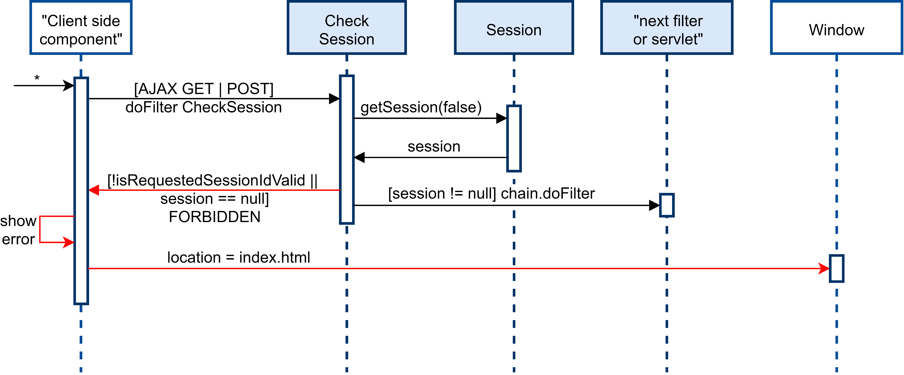
Filter: check if the user is authenticated

Slide 57
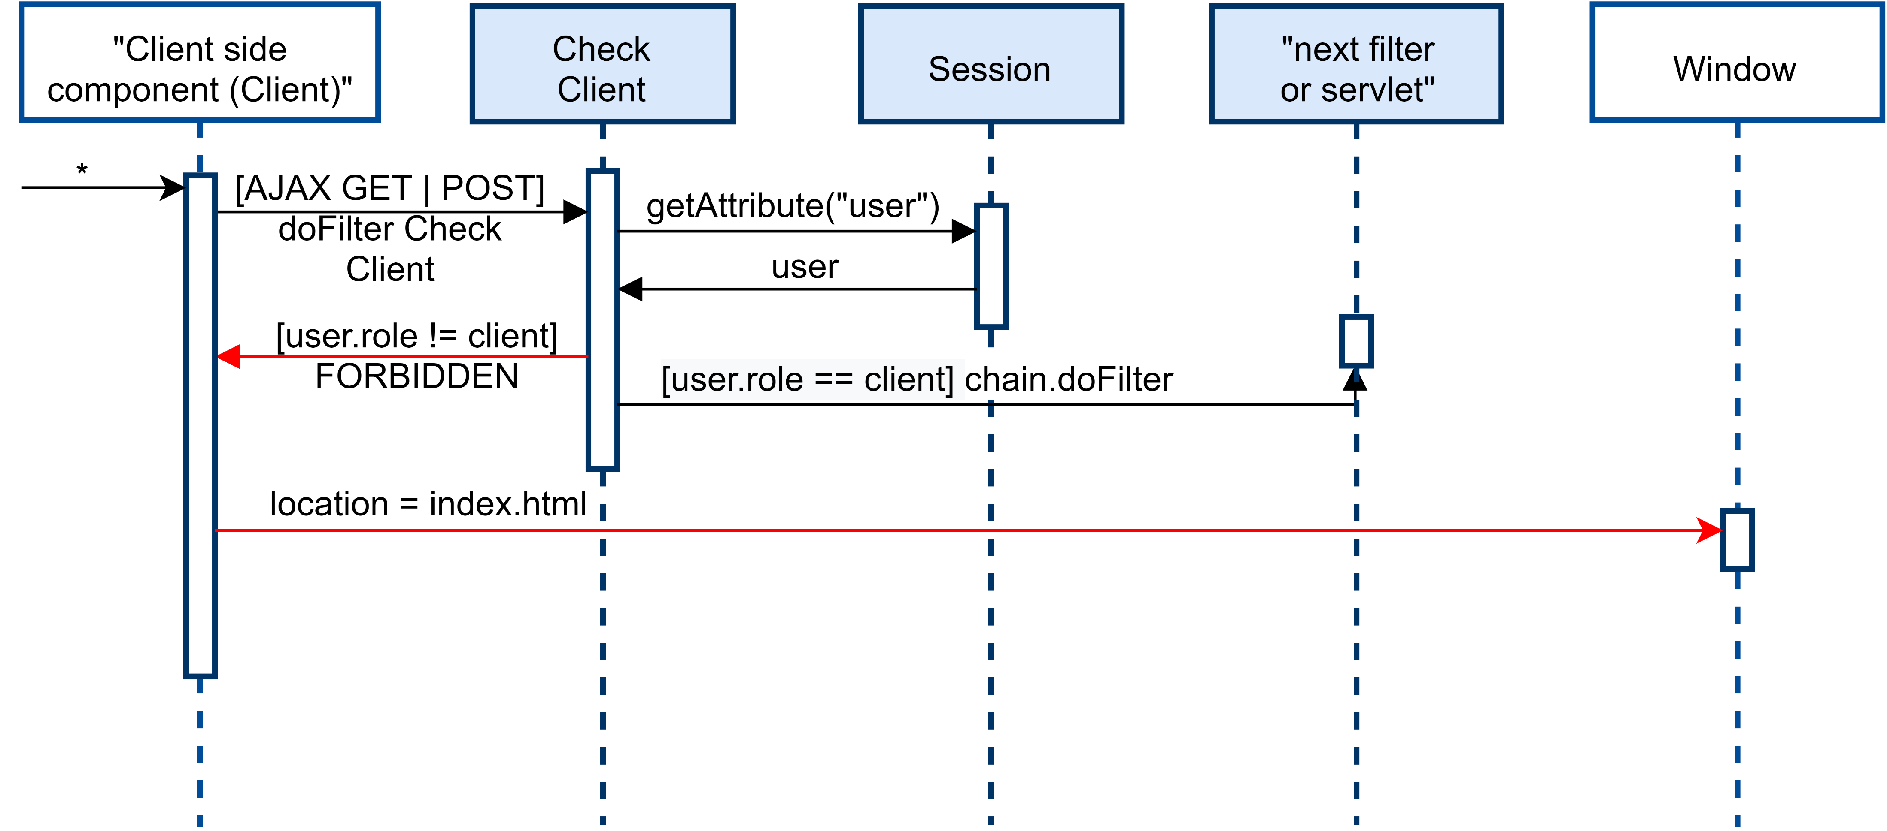
Filter: check if the user is a client

Slide 58

Filter: check if the user is a worker

